Slide 1
F# 6 Fundamentals
Getting Started with F# 6 and .NET 6
Michael Heydt
Developer and Trainer
@mikeheydt www.smac.io
Notes:
Hello, and welcome to F# 6 Fundamentals.
My name is Micahel Heydt, and I’m very exicted to bring to you this course and to have you join me in learning f#.
We’re going to have a lot of fun learning about this awesome programming language.

Slide 2

Learning F# is awesome!
It will make you a better programmer
Notes:
F# is one of the programming languages on the .NET platform,
and while it’s not as popular as say, c#, it’s awesome for building applications and services.
It has a rich history, is actively maintained and evolving, and has full support of the .net platform capabilities.
And any type of application you can build with .NET, you can also build with F#.
It’s different from C# in it is a functional first programming language,
focusing on declaratively expressing what to do and now how to every little detail.
Code written in F# is often much more concise than equivalent object oriented code, and often more correct and error free.
Simply said, learning F# will make you a better programmer, even in OO languages such as C#.

Slide 3

Hello .NET
Developer Platform
Open Source
Cross-Platform
Notes:
What’s .NET then?
.NET is a developer platform created by Microsoft for us to use to develop applications and services.
It’s gives the developer a rich set of tools to build just about any type of application.
NET is open source too, so you can go an see all of the code that it is built with.
It is also clross platform. This has been true for several variants of .net from .net core onwards, but .NET 6 brings true cross platform allowing your apps to run on windows, linux, mac and many mobile platforms.

Slide 4
What Can You Do with .NET?
.NET 6
Notes:
So what can you build with .NET? Well, the simple answer is almost anything.
You can start with simple apps and learn some basics, which is what we will do in this course with F#.
But you can build all kinds of applicaitons
But .NET has got you covered, and can grow with you to build all sorts of applications including desktop applications with a graphical interface, cloud apps, web applications, games, mobile applications, and even AI, or applications powered with artificial intelligence. .NET is quite frankly huge.
When we are building applications with .NET, we are tapping into the entire ecosystem that will help you with all your endeavors. .NET contains several languages that we can use to write our code. There's a very extensive set of libraries that you can use, which offers a lot of functionalities that's already been created for you, both from Microsoft and from the community. And finally, .NET comes with several tools that you can use to create your applications. Tools are available for all environments including Windows, Mac, and Linux, thus giving everyone the ability to write .NET applications. In this course, we are using .NET 6. One of the cool things about .NET 6 is that it can run everywhere. .NET 6 is what we call cross‑platform. It is not tied to just Windows, for example. So just like the tools we use to create them, the applications we create with .NET can run on Windows, Linux, and Mac. As I just mentioned, there are different languages available to write your .NET applications, one of them being C#. In this course, we will be using C# 10. Other languages include Visual Basic and F#. To follow along with this course on C#, no previous knowledge about the language is required. This course will teach you everything you need to know right from the very beginning, so this course is aimed at learning how to write .NET applications with C#. If you're coming from another language like Java or C++, this course will be a great fit too, to help you gain the required knowledge to write C# applications. I will assume only some very basic understanding of programming concepts, but again, just the very basics. If you don't have these yet, or are in doubt, no worries, we've got you covered. We have an amazing course here on Pluralsight called What Is Programming, of which you can see the link here on the slide. Take a look at this course if you want to understand the basics about computer programming. Through this course, we will be building a few applications together. How great is that? And all of these are focused on one of our customers, Bethany. She runs a store where she sells the most amazing pies, called Bethany's Pie Shop, and we are building the software for her business. We will be looking at some applications to manage her staff throughout this course. The concepts used in this course include employees, managers, wages, taxes, and so on, so pretty general concepts that should be clear to understand. I am a big fan of doing rather than watching a course. For that reason, the entire course is built so that you can follow along with everything I'm doing. Please, try to write the code I am writing. You will learn a lot this way. To be able to follow along, you'll need the exercise files, which you can find here on the Pluralsight website. Head over to the Exercise files tab to start the download. Oh, and before I forget, please post any questions you may have under the Discussion tab. I'm happy to help with any issue you encounter with this course. This course was created using C# 10, which is, at the time of the recording of this course, the latest version. C# is part of .NET and so we are, again, using the latest version here too, which is, as mentioned, .NET 6. We will soon talk about the different options you have to create your applications. I'm using the latest version of Visual Studio, which is the 2022 edition, and I'm using the free edition named the Community Edition. All coding samples will run perfectly fine if you use the same version that I'm using. However, nearly all C# features that we will be using in this course will work fine with older versions too. I won't be going into any detail about what works where, since that would be a tedious task, but as said, most samples will run fine with older versions too. I do recommend, if possible, to work with a new version of the tools and language, like we are doing here. .NET and C# evolve quickly nowadays, so it's best not to stay behind. With all of this out of the way, we're ready to start learning C#, so let's get our hands dirty, shall we? We now already know a bit about .NET, so it's time to learn a bit more about what C# is, and we'll do that in the first part called Hello C#. I did mention I hope you follow along with me during this course, and I will therefore make sure that you have everything you need, so we'll set up your machine next. With the tools installed, we will create our first C# program together and we'll understand the basics of the C# language already. Sadly, while writing code, we'll make errors and we'll introduce bugs in our code. Those can be nasty to find, but we're in luck. .NET comes with a great debugger that will help us greatly to pinpoint errors in our applications, and I'll show you how to use this next. We can also create applications using a CLI, a command line interface, that is. I will show you this alternative option here as well. Finally, understanding how to find things you don't know is hugely important, so in the last part of this module we'll explore the wonderful .NET docs, which are indispensable when learning about C# and .NET. I am excited to get started, and I hope you are too. Let us dive in.

Slide 5

What Can You Do with .NET?
.NET 6
Notes:
So what can you build with .NET? Well, the simple answer is almost anything.
You can start with simple apps and learn some basics, which is what we will do in this course with F#.
But you can build all kinds of applicaitons,
Such as desktop apps with graphical user interfaces
But .NET has got you covered, and can grow with you to build all sorts of applications including desktop applications with a graphical interface, cloud apps, web applications, games, mobile applications, and even AI, or applications powered with artificial intelligence. .NET is quite frankly huge.

Slide 6

What Can You Do with .NET?
.NET 6
Notes:
Cloud apps
But .NET has got you covered, and can grow with you to build all sorts of applications including desktop applications with a graphical interface, cloud apps, web applications, games, mobile applications, and even AI, or applications powered with artificial intelligence. .NET is quite frankly huge.

Slide 7

What Can You Do with .NET?
.NET 6
Notes:
Web applications

Slide 8

What Can You Do with .NET?
.NET 6
Notes:
Games

Slide 9

What Can You Do with .NET?
.NET 6
Notes:
Mobile apps

Slide 10

What Can You Do with .NET?
.NET 6
Notes:
AI

Slide 11

What Can You Do with .NET?
.NET 6
Notes:
FInancial

Slide 12

What Can You Do with .NET?
.NET 6
Notes:
And data science
F# is really popular in the services, finance and data science

Slide 13



The .NET Ecosystem
Languages
Libraries
Tools
Notes:
.NET is quite frankly huge.
When building apps with .NET, and also with F#, you get access to the whole ecosystem of .NET to assist you.
This includes several programming languages, that fit different needs, primarily OO and functional, as well see the later with F#.
There's a huge set of existing libraries and open source projects available.
And honestly, this has been one of the great areas of growth and strength with .NET since becoming cross platform and open source.
The selection of libraries available are robust and let you focus on just building your business logic.
And there are a great set of both free and for pay tools that can be used to build apps, and across windows, mac and linux.

Slide 14
.NET 6
Cross-platform
Notes:
In this course, we are using .NET 6, and F# version 6.
.NET 6 is truly cross platform and can run anywhere. Dependendies on windows that were in previous versions have been complete removed. Tools exist for each platform, and the apps built with it can run on all of them too.

Slide 15

The Languages of .NET
F#
C#
Visual Basic
Notes:
We will be focusing on F#, but there are multiple languages on .NET to write code with.
F# is it the functional language
C# is OO
And VB is also OO

Slide 16

No F# knowledge is required
Notes:
To follow along with this course, you will not need any knowledge of F#.
This course will teach you everything you need to know from the ground up and is aimed at learning the foundations of F# apps on .NET.
If you have knowledge of other programming languages, in particular C#, then that will help, along with having some fundamental knowledge of the .NET platform.
But F# is functional in nature, and hence the way things are done in the language are often very different from OO and languages such as C#.
But having some exposure to them is convenient as a point of contrast.

Slide 17

Transaction Processing System
- Record and process financial transactions
Notes:
During this course I’ll go over many demos that demonstrate the concepts of F# and functional programming.
Financial app, streams of transactions, time series data, and calculating current state. A kind of time is money system, using common scenarios in financial systems, as well as time-series, and apps build with F#.
It’s by no means the only application, but it’s one that demonstrates solution patterns unique to F#.
And hence this will not just be a theoretical course, you will get practical knowledge. How cool is that?
Elements:
Event Source
Different Accounts / customers
Persistent data storage
Search on the events
Calculating current state / valuation
But we will also build an application together to demonstrate F# in practice and performing common tasks in application such as:
Collecting user input
Representing different types of data and logic, using functional pattern.
Calculating aggregate and polymorphic
Parsing data
Storing/reading data to files
Inverting dependencies to make the application more composable and robust
`

Slide 18

Follow along with everything!
Notes:
I’m a big believer in learning via doing.
Nothting makes an imprint on memory like following along and writing / executing code.
All the code I show is available in the exercise files in the course content on the Pluralsight website.
So go and get those if you want to follow along.
And also, if you have questions, please ask them in the course discussion group as I love to help out in that environment and augment the learning experience.

Slide 19
This version was created using:
F# 6.0
.NET 6.0 (6.0.201)
Visual Studio Code 1.64.2
Ionide-fsharp 5.12.0
Version Check
Notes:
Recommended script:
“This slide shows the versions of [major tool, framework, language, etc.] for which the information in this course applies.”

Slide 20
This course is 100% applicable to:
F# 6.0
.NET 6.0
Visual Studio Code
Ionide-fsharp
Most code will be compatible with older versions of F# and .NET
Version Check
Notes:
Recommended script:
“This slide shows the versions of [major tool, framework, language, etc.] for which the information in this course applies.”

Slide 21
Hello F#
Tools to build and run F# code
Configuring an F# development environment
F# and the .NET command line interface
Using F# with Visual Studio Code
Running F# scripts with dotnet fsi
F# Programming Quick Start
Overview
Notes:
With all of this introduction to the course and .NET ecosystem out of the way, let’s start getting our hands dirty learning F#.
We’ll start this by starting with a first lesson called hello f# where we’ll learn a bit of the history of F#, what you can build with it, and WHY you would use F#.
Then we will learn about the various tools that you will need to use to develop in F#, third party tools, and both IDE, interactive and notebook environments.
I intend that you can follow along with this course with your own environments, so I’ll walk you through setting up an F# development environment and show you several means of using them.
We’ll then start creating code from the ground up.
We will start by learning how to use the .NET CLI to create, build and run F# projects.
Then we will shift our focus to Visual Studio Code, and we’ll use Visual Studio Code to run and debug F# projects, and also to use the environment to interactively run F# code in script files interactively with F# interactive, all within VS Code.
And we’ll finish this first module there, leaving you with knowledge of using the tools in various patterns to utilize F#, setting you up for the following module where we start diving deeply into F#.
Let’s dive in.

Slide 22
Hello F#
Notes:
Now lets start getting familiar with F#. In this lesson we’ll learn some of the history of F#, what you can do with it, and the reasons for you would want to use it.

Slide 23
Hello F#
.NET’s Functional Programming Language
Static typed and type safe
Functional, imperative and OO styles
OCaml-based
Notes:
F# is the is .NET’s functional programming language.
It is statically typed and type safe, which means that the compiler can check that we are using types and functions correctly and find errors at compile time.
F# has its roots in the Caml/Ocaml family of langugages, which provide a combination of functional, imperative and OO styles.
Caml first appeared in 1987, and Objective Caml, in 1996. It was renamed Ocamel in 2011) so it’s been around a while.
So if you have worked with any Ocaml based languages, F# will feel very familiar.
And if you have been using the new features of C# 10, then some concepts may feel familiar, such as record types.
That’s because as C# has evolved, it has adopted many functional programming concepts that have actually existed in F# for quite a while.
That’s why I say if you are a C# programmer, F# is great to learn as it will make you a better C# programmer by learning the functional patterns that C# ever evolves support.

Slide 24
F# Timeline
2005
2010
2012
2013
2015
2017
2018
2019
2019
2020
2021
1.0
2.0
3.0
3.1
4.0
4.1
4.5
4.6
4.7
5.0
6.0
Notes:
F# is an actively maintained programming language and has been evolving since its first version in 2005.
It is developed using an open development process with its users and Microsoft.
It is actively maintained, as has had many updates over the last 16 years.
Many of these brough major new features (the major versions). Such as F# 6 adding more adv
While many were minor releases that added more capabilities, particularly around integration with .NET.
Older versions of F# are compatible with newer versions, so old code will compile and run. That’s a big part of the open process and moving the language forward without breaking things.
That being said, F# is mature and now generally focuses on enhancements for ease of use and performance.

Slide 25
What Can I Build with F#?
Console Applications
Desktop Applications
Web Applications
Mobile Applications
Services and Microservices
Notes:
F# is a language for creating code that runs on .net, and you can build just about any type of “application” and run them anywhere .NET runs.
I use application loosely as a trend today is services that implement small parts of applications, so I don’t want you to think of monoliths.
In fact, F# has great adoption in developing microservices.
And since .NET can run almost anywhere, then so can your F# code.
In this course we will focus on console applications. We are mostly focused on learning F# programming, and this will keep things simple and focused on the language. These apps use the terminal and a text based interface to interact with the user.
F# can also be used to build desktop applications, such as WPF applications, with rich interfaces, displaying information and collecting data from users, all run on a user desktop.
An area where F# is often overlooked is in developing web applications. Templates in .NET 6 come with bindings for web applications, including Razor applications.
And there are open source libraries such as Giraffe, Saturn, Fable, SAFE stack, and WebSHarper, that bring functional programming and patterns support to web apps on .NET with alternate options to the asp.net and razor defaults.
There’s been some work done in Blazor, but that is yet unreleased. I personally can’t wait for F# in blazor.
Mobile apps can also be built, using libararies such as Fabulous and Xamarin Forms to run on iOS and Android, all with F#.
And last but definitely not least, is services, and specifically microservices, where F# excels. F# has shown signification adoption in financial services, and in particular for microservices running in containerized environments such as Kubernetes.
Console apps are “command line” based and take input directly from users, or listen to network.

Slide 26
Why Use F#?
Conciseness
Convenience
Correctness
Concurrency
Completeness
Notes:
A question that always comes up is why use F#? Let’s examine five areas where F# becomes attractive to a developer.
* Conciseness
F# is not cluttered up with coding “noise” such as curly brackets, semicolons and so on.
You almost never have to specify the type of an object, thanks to a powerful type inference system.
And, compared with C#, it generally takes fewer lines of code to solve the same problem.
* Convenience
Many common programming tasks are much simpler in F#.
This includes things like creating and using complex type definitions, doing list processing, comparison and equality, state machines, and much more.
And because functions are first class objects, it is very easy to create powerful and reusable code by creating functions that have other functions as parameters, or that combine existing functions to create new functionality.
* Correctness
F# has a powerful type system which prevents many common errors such as null reference exceptions.
Values are immutable by default, which prevents a large class of errors.
In addition, you can often encode business logic using the type system itself in such a way that it is actually impossible to write incorrect code or mix up units of measure, greatly reducing the need for unit tests.
* Concurrency
F# has a number of built-in libraries to help when more than one thing at a time is happening.
Asynchronous programming is very easy, as is parallelism.
F# also has a built-in actor model, and excellent support for event handling and functional reactive programming.
And of course, because data structures are immutable by default, sharing state and avoiding locks is much easier.
* Completeness
Although it is a functional language at heart,
F# does support other styles which are not 100% pure,
which makes it much easier to interact with the non-pure world of web sites, databases, other applications, and so on.
In particular, F# is designed as a hybrid functional/OO language, so it can do virtually everything that C# can do.
Of course, F# is part of the .NET ecosystem, which gives you seamless access to all the third party .NET libraries and tools. It runs on most platforms.
And as we will see, there are a lot of great tools to help you develop with F#, including IDE’s, debuggers, and testing tools.

Slide 27
F# and the .NET CLI

Slide 28

The .NET CLI
The command line interface for .NET
Cross-platform
Create, build and run F# .NET projects
Run F# scripts

Slide 29
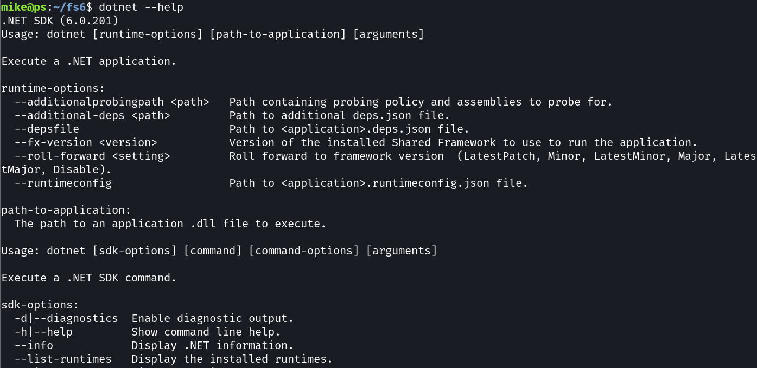
The “dotnet” Command

Slide 30
dotnet --list-runtimes
dotnet --list-sdks
dotnet new
dotnet build
dotnet run
dotnet watch
dotnet fsi
List installed .NET runtimes
List installed .NET SDK’s
Create a new project
Compile the project
Execute the project
Watch for changes in the project and build / run
Start the F# interactive terminal or run scripts

Slide 31
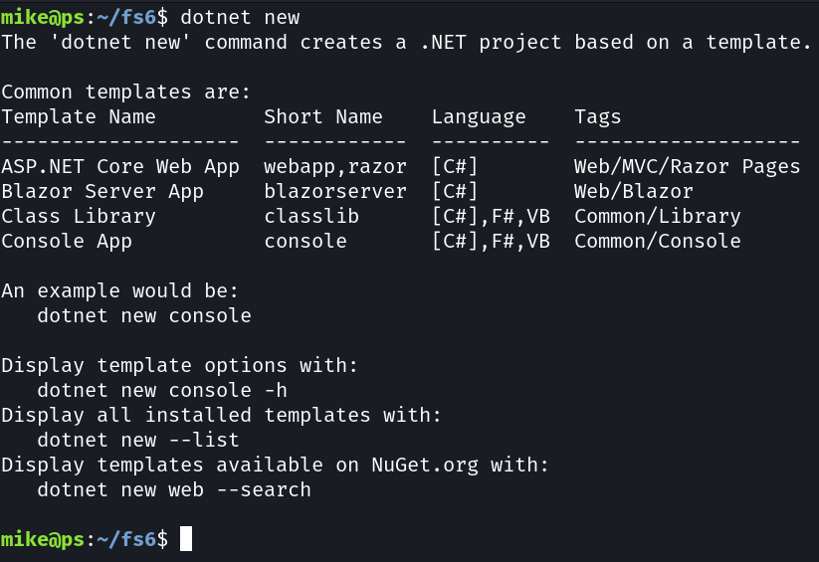
New Project

Slide 32


.NET F# Projects
Source Files
A project is a one or more source files that contain source code
Assemblies
Source files are compiled into assemblies that can be executed or reused

Slide 33
Create a New F# Project
dotnet new console -n fsharp1 -o src/fsharp1 -lang f#

Slide 34
Create a New F# Project
Create a new project
dotnet new console -n fsharp1 -o src/fsharp1 -lang f#

Slide 35
Create a New F# Project
dotnet new console -n fsharp1 -o src/fsharp1 -lang f#
Template

Slide 36
Create a New F# Project
Name of the project
dotnet new console -n fsharp1 -o src/fsharp1 -lang f#

Slide 37
Create a New F# Project
dotnet new console -n fsharp1 -o src/fsharp1 -lang f#
Location

Slide 38
Create a New F# Project
Use F#!
dotnet new console -n fsharp1 -o src/fsharp1 -lang f#

Slide 39
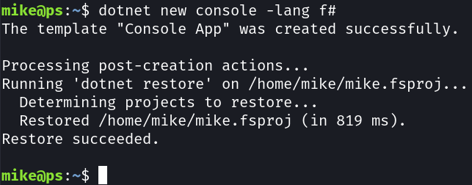
Create a New F# Project
dotnet new console -n fsharp1 -o src/fsharp1 -lang f#

Slide 40
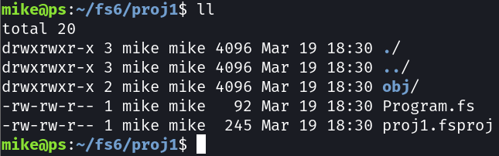
New F# Project Structure

Slide 41
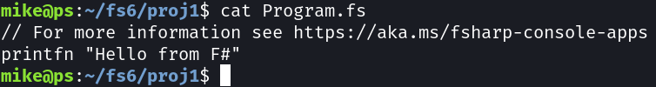
.NET 6.0 Default Application

Slide 42
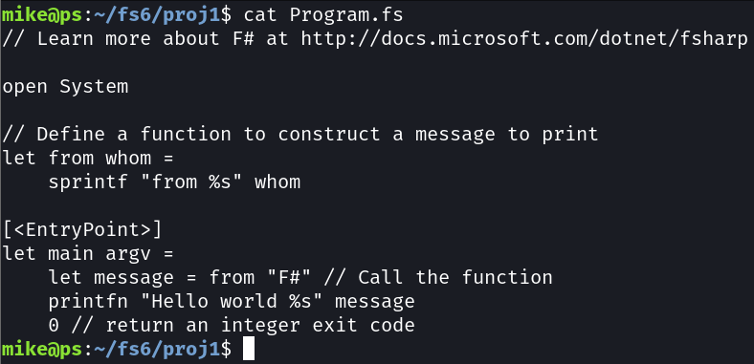
.NET 5.0 Default Application

Slide 43
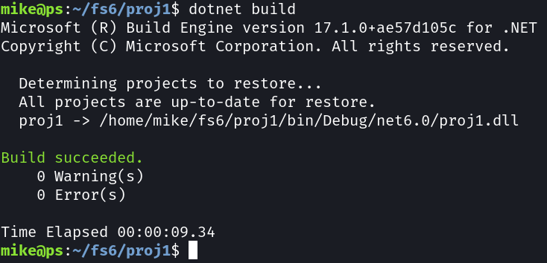
Build F# Project
dotnet build

Slide 44
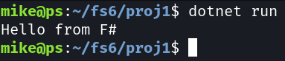
Build F# Project
dotnet run

Slide 45
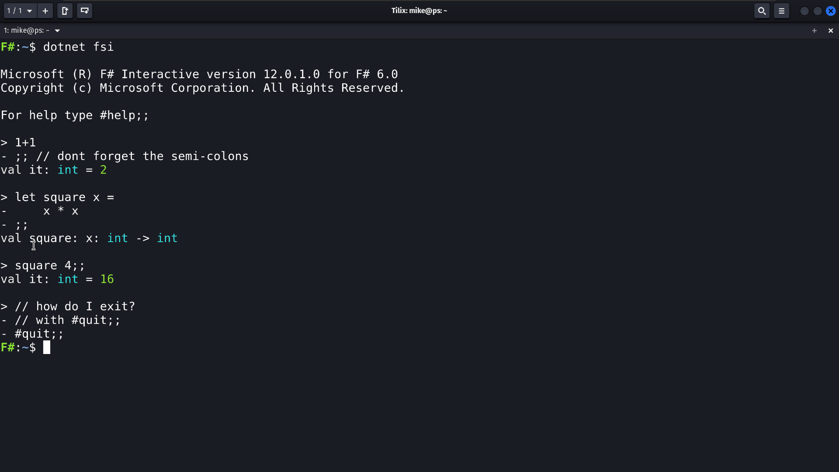
F# Interactive

Slide 46
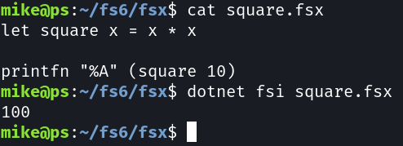
Run an F# Script
dotnet fsi [script.fsx [<arguments>]]

Slide 47
F# Tools

Slide 48
F# Tools
.NET SDK
Visual Studio
Visual Studio Code / Ionide-fsharp
JetBrains Rider
F# Interactive
.NET Interactive / Notebooks

Slide 49
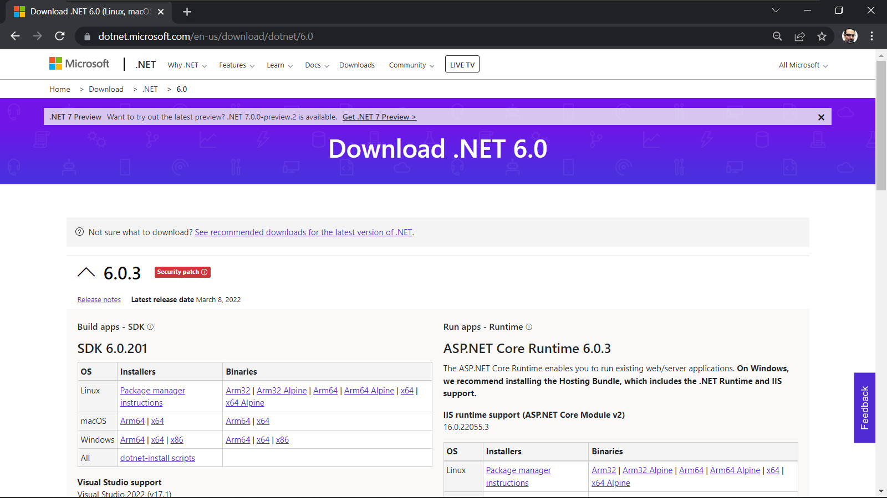
.NET 6.0 SDK

Slide 50
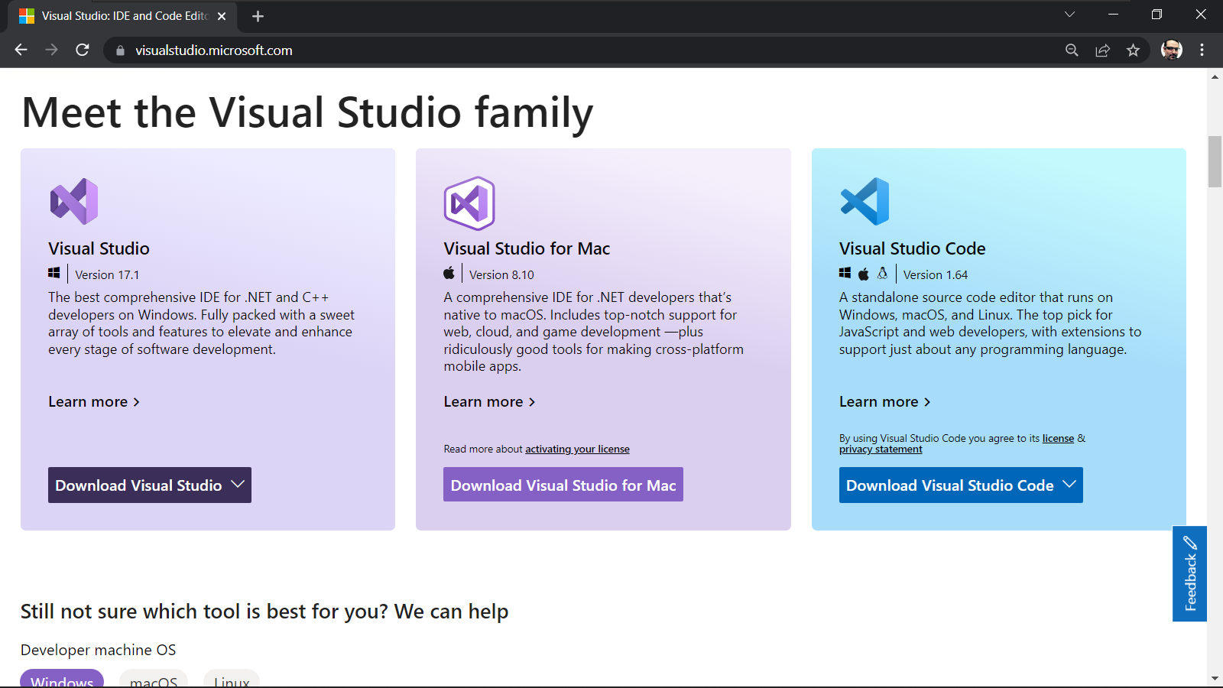
Visual Studio

Slide 51
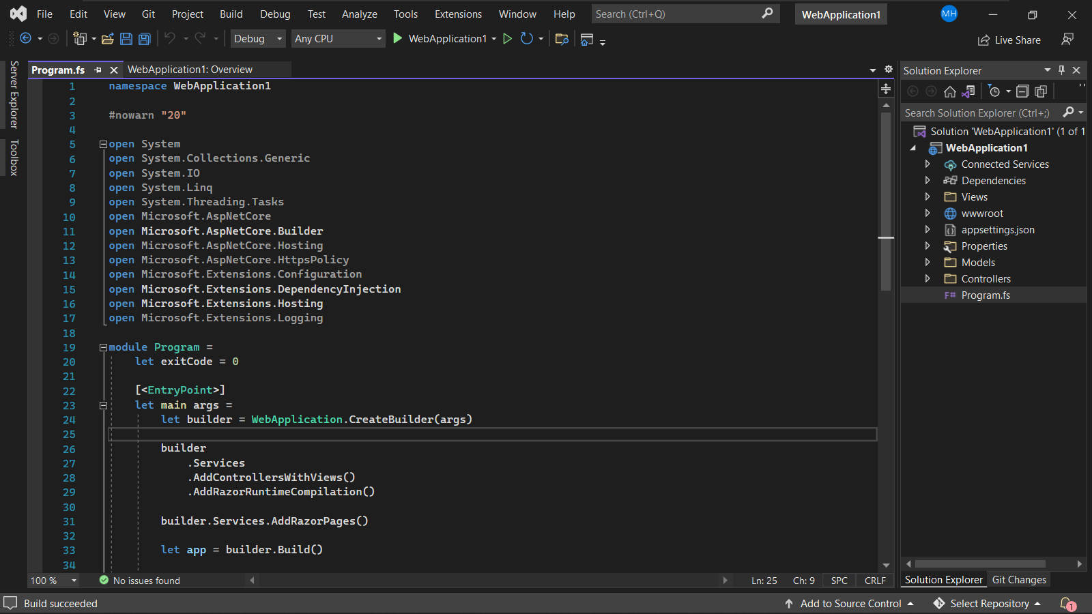
Visual Studio and F#

Slide 52
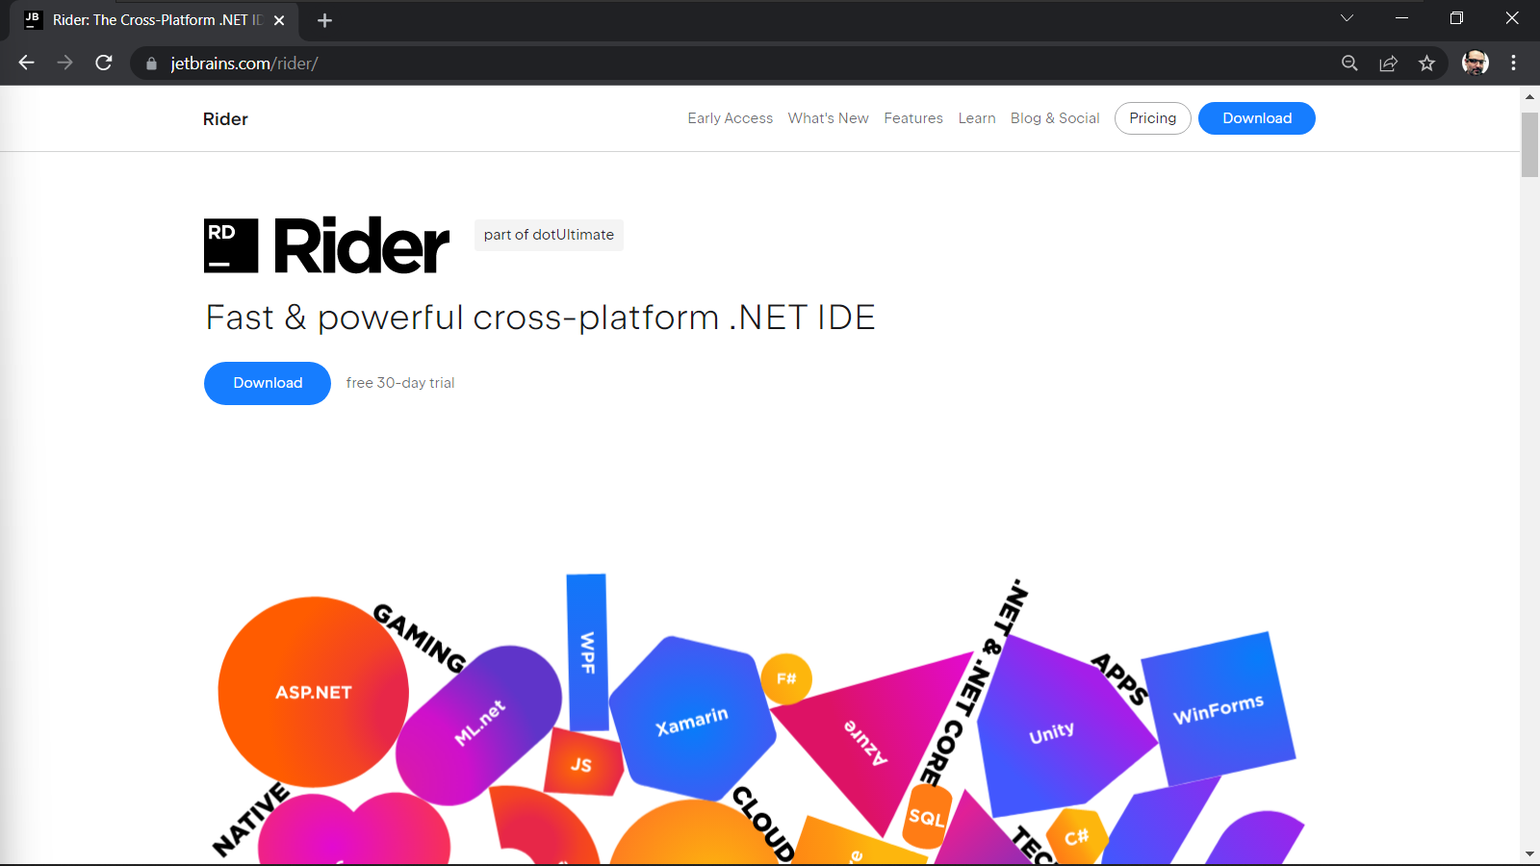
JetBrains Rider

Slide 53
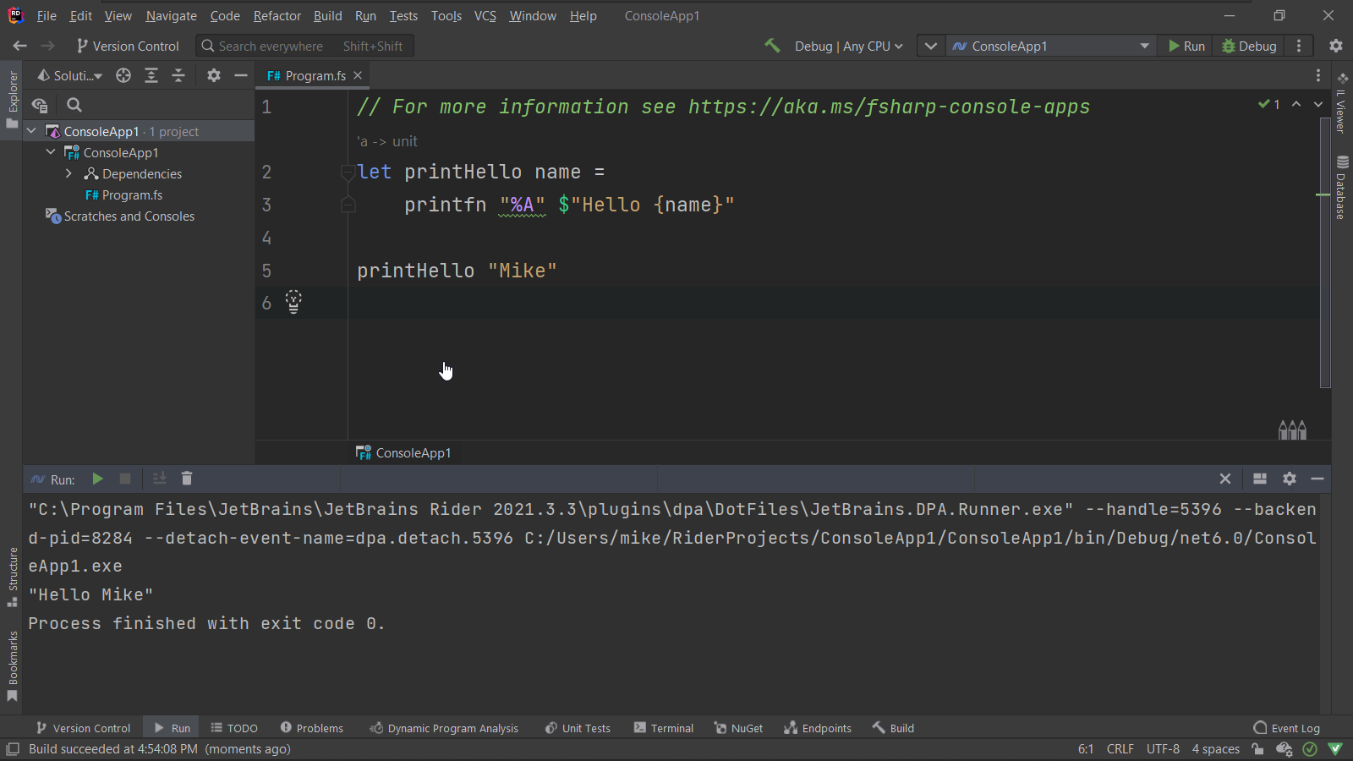
JetBrains Rider

Slide 54
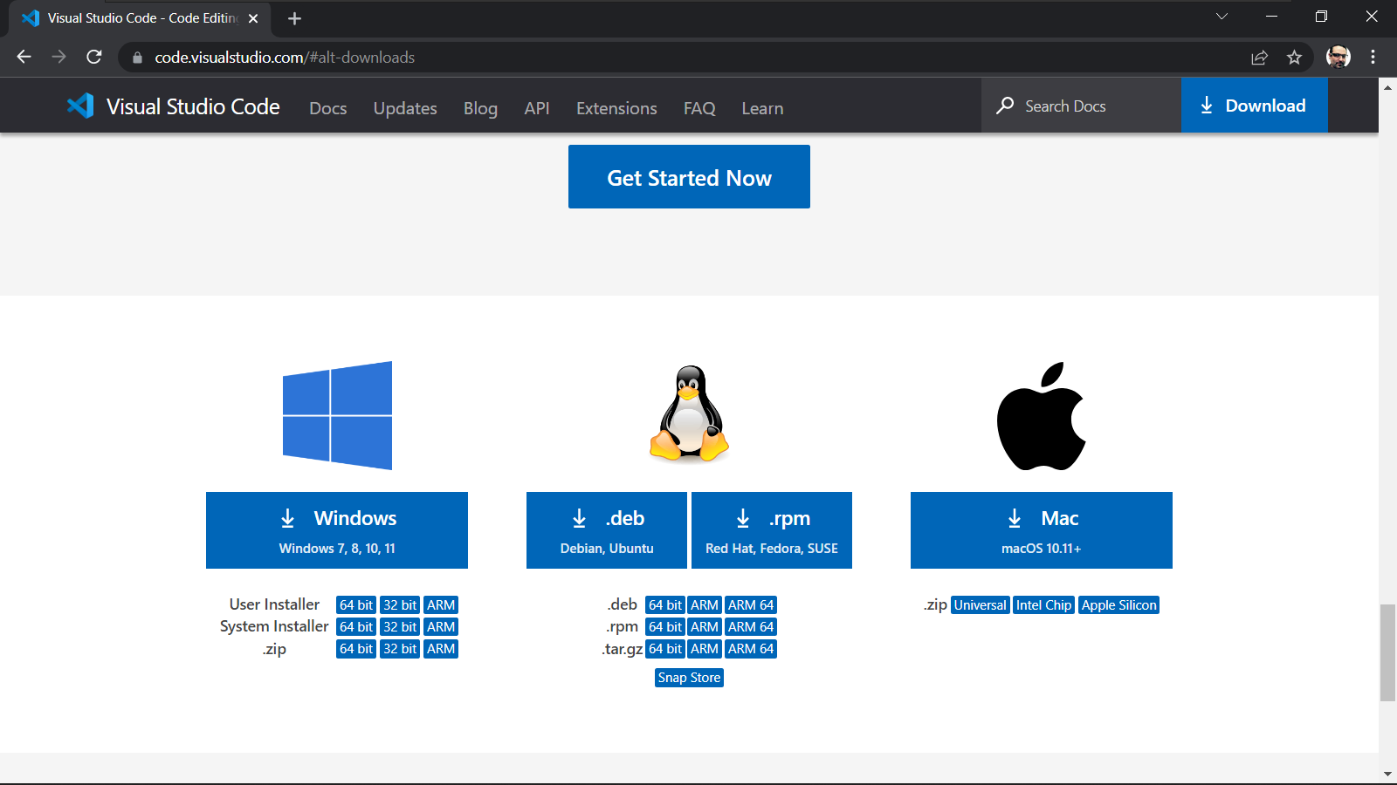
Visual Studio Code

Slide 55
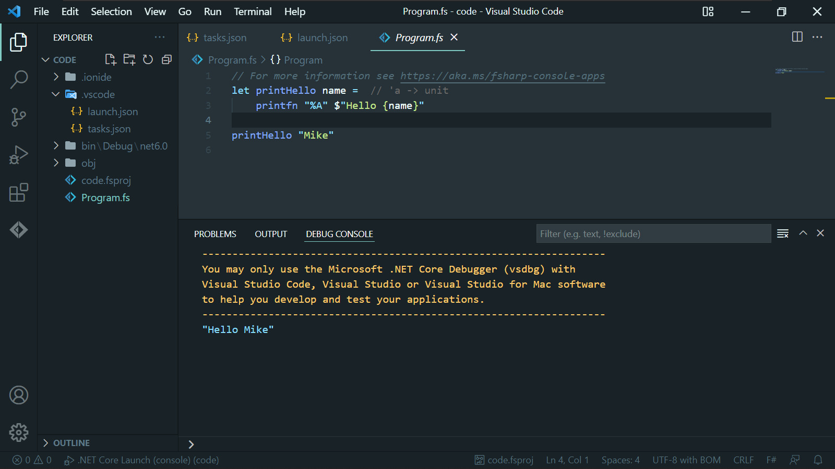
Visual Studio Code

Slide 56
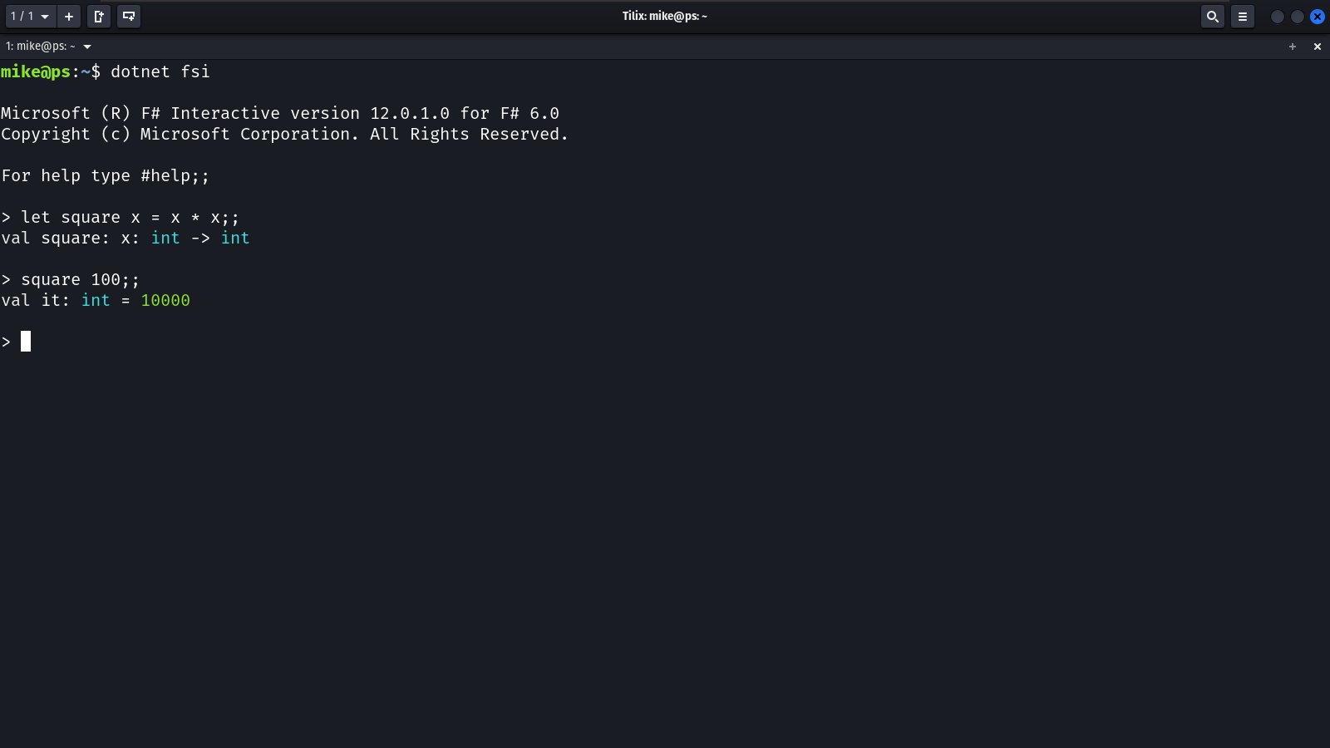
F# Interactive

Slide 57
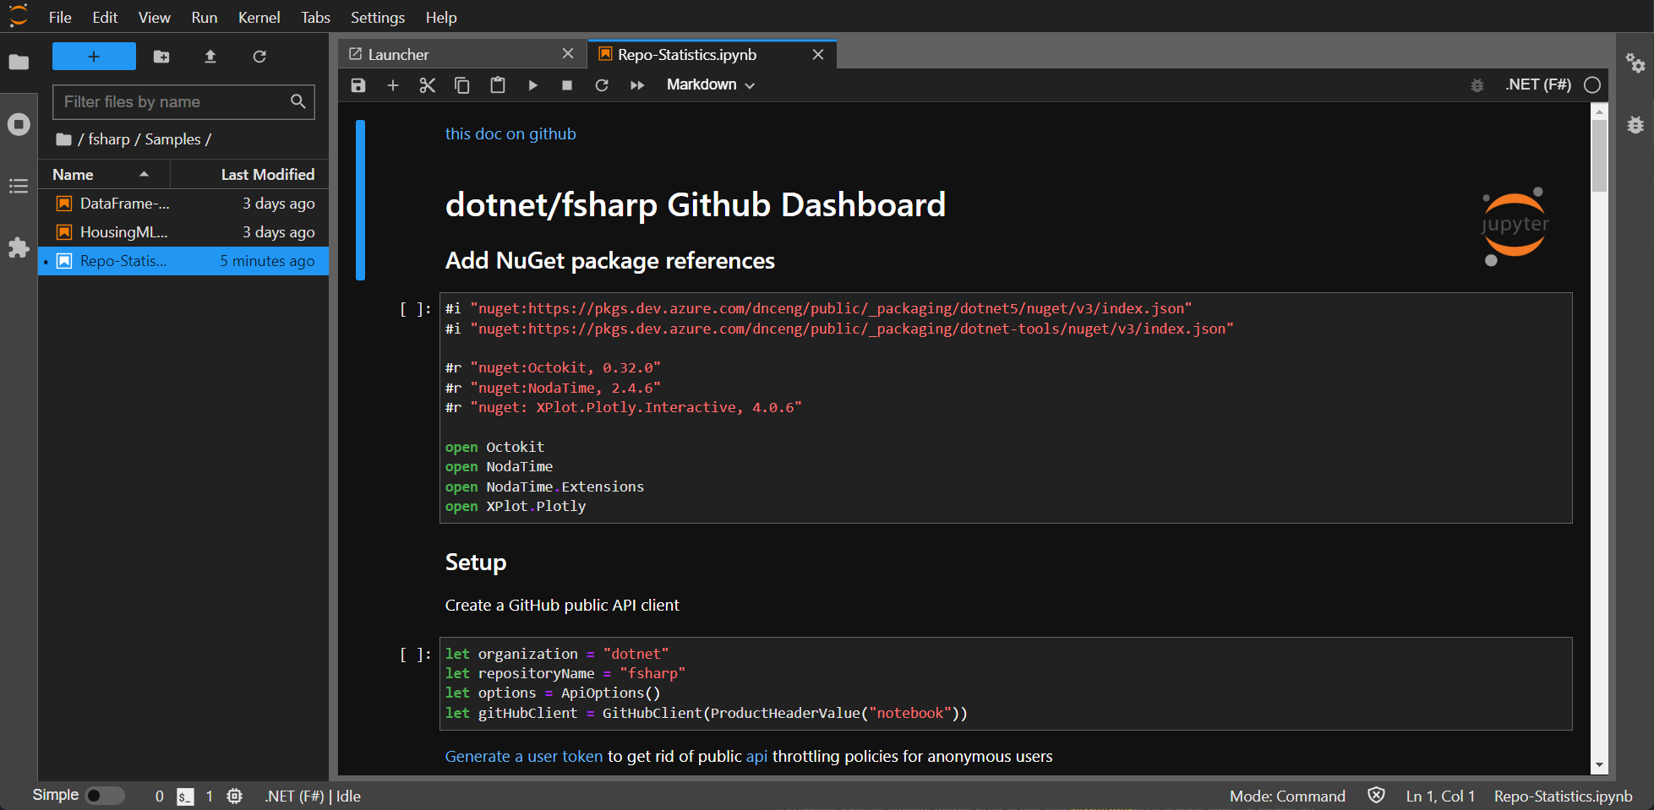
Jupyter Notebooks / F#

Slide 58
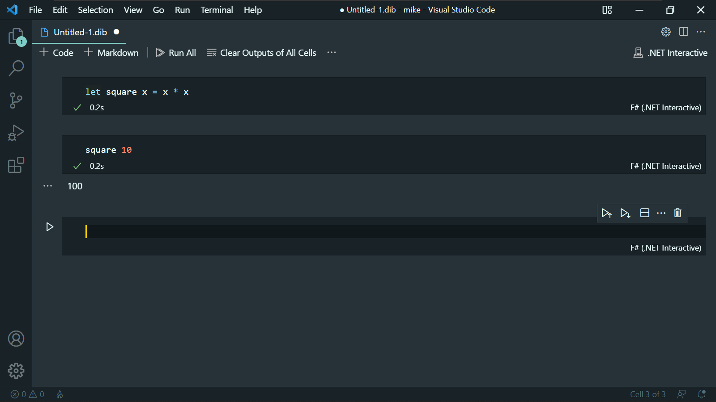
.NET Interactive

Slide 59
Configure F# Dev Environment on Windows
Install .NET 6.0 SDK
Install Visual Studio Code
Install ionide-fsharp

Slide 60
Configure F# Dev Environment on Ubuntu
Install .NET 6.0 SDK
Install Visual Studio Code
Install ionide-fsharp

Slide 61
Create and run an F# console app with the CLI
Create project with “dotnet new”
Build project with “dotnet build”
Run project with “dotnet run”

Slide 62
Create and run an F# script
Create an FSX script
Send code from the editor to FSI
Run an FSX with the dotnet CLI

Slide 63
Create and run an F# app within VSCode
Start VSCode
Create project with ionide-fsharp
Configure VS Code to run F# the project

Slide 64
Debugging an F# app within VS Code
Configuring breakpoints
Examining program state

Slide 65
F# is a functional and type-safe programming language to write .NET applications
F# is actively maintained
F# can be used to build any type of .NET application
Learned to use the .NET CLI and VS Code to work with F#
Learned the basics to getting an F# program up and running
Summary
Notes:
Congratuations, you have already created a small F# program
It’s a small program, but you will grow it over the course
You’re on your way to being a real F# programmer
And now lets have a recap to summarize what we’ve covered in this module

Slide 66
Up next:
F# Basics
Notes:
Now that you are on track to becoming and F# developer,
And you have everything is installed to continue
It’s time to start to learn functional programming
And that’s exactly what you;’ll do in the next module

Slide 67
F# 6 Fundamentals
Basics of F# Programs
Michael Heydt
Developer and Trainer
@mikeheydt www.smac.io
Notes:
Hello, and welcome to F# 6 Fundamentals.
My name is Micahel Heydt, and I’m very exicted to bring to you this course and to have you join me in learning f#.
We’re going to have a lot of fun learning about this awesome programming language.

Slide 68
Overview
Notes:
With all of this introduction to the course and .NET ecosystem out of the way, let’s start getting our hands dirty learning F#.
We’ll start this by starting with a first lesson called hello f# where we’ll learn a bit of the history of F#, what you can build with it, and WHY you would use F#.
Then we will learn about the various tools that you will need to use to develop in F#, third party tools, and both IDE, interactive and notebook environments.
I intend that you can follow along with this course with your own environments, so I’ll walk you through setting up an F# development environment and show you several means of using them.
We’ll then start creating code from the ground up.
We will start by learning how to use the .NET CLI to create, build and run F# projects.
Then we will shift our focus to Visual Studio Code, and we’ll use Visual Studio Code to run and debug F# projects, and also to use the environment to interactively run F# code in script files interactively with F# interactive, all within VS Code.
And we’ll finish this first module there, leaving you with knowledge of using the tools in various patterns to utilize F#, setting you up for the following module where we start diving deeply into F#.
Let’s dive in.

Slide 69
Entry Points and Command Line Arguments

Slide 70

Entry Points
Define where the program starts running

Slide 71
F# Application Entry Points
Implicit
Utilizes .NET top level statements
Explicit
Declare a function as “main” with [<EntryPoint>]

Slide 72
Implicit entry point
printfn "Hello from F#“
// can get arguments this way
let argv = System.Environment.GetCommandLineArgs()
printfn "Hello from F#“ argv // [|”path to dll”; ... Other arguments|]
Utilizes .NET top level statements
Last file in compile listing is used for startup
Command line arguments can be accessed via System.Environment.GetCommandLineArgs()
Command line arguments include at least the executing dll full path

Slide 73
Explicit entry point
[<EntryPoint>]
let main argv =
printfn “%A“ argv // [|arguments list|]
0
Only one function in a project can annotated, and function must be at the end of its file
That file must be the last file to be compiled
Must return an integer (0 generally means success)
Command line arguments do not include the dll path

Slide 74
Configuring arguments in VS Code
"configurations": [
{
"name": ".NET Core Launch (console)",
"type": "coreclr",
"request": "launch",
"preLaunchTask": "build",
"program": "${workspaceFolder}/bin/Debug/net6.0/demo.dll",
"args": [],
"cwd": "${workspaceFolder}",
"stopAtEntry": false,
"console": "integratedTerminal"
}
Launch.json file, “args” property

Slide 75
Entry points and command line arguments
Start an F# app with implicit entry point
Retrieve explicit command line arguments
Configure launch.json to pass arguments
Modify F# app to use an explicit entry point
Handle explicit command line arguments

Slide 76
Console I/O and Command Line Arguments

Slide 77
Console Input and Output
Interacting with the user via the terminal

Slide 78
.NET Versus F# Console
.NET
F# can access the Console class in .NET for input and output
F#
Output only, with print* functions which have special knowledge of F# types

Slide 79
Console Output
let a = [|1; 2; 3|] // array
printfn "%A" a // [|1; 2; 3;|]
System.Console.WriteLine(a) // System.Int32[]
F# has its own console output with printf / printfn
.NET console class can also be used

Slide 80
printf / printfn
Format specifier
Meaning
%A
%s
%c
%d, %i
%f, %F
%b
%%
Any value
String
Char
Decimal integer
Floating point
Boolean (output ‘true’ or ‘false’)
Just a ‘%’

Slide 81
Console Input
printf "Enter your command human: "
let input = System.Console.ReadLine(); // read input from the console
printfn “Your command is: %A" input
Console input uses the System.Console.Read* methods in .NET

Slide 82
Console Input in VS Code
"configurations": [
{
"name": ".NET Core Launch (console)",
"type": "coreclr",
"request": "launch",
"preLaunchTask": "build",
"program": "${workspaceFolder}/bin/Debug/net6.0/demo.dll",
"args": [],
"cwd": "${workspaceFolder}",
"stopAtEntry": false,
"console": "integratedTerminal"
}
]
Make sure to switch “console” in launch.json to “integratedTerminal”

Slide 83
Using open for console classes
open System // opens System, like using in C#
printf "Enter your command human: "
let input = Console.ReadLine(); // read input from the console
printfn “Your command is: %A" input
Can open the System namespace to make code simpler

Slide 84
Console input / output in F#
Using printfn function
Using System.Console for output
Using open to bring in a .NET namespace
Reading input from the console
Configuring the app to use the integrated terminal for console input

Slide 85
F# Primitive Data Types

Slide 86
Built-in Data Type Categories
.NET
Access to all .NET data types (including objects), many with aliases as primitives
F#
F# specific types to facilitate functional styles (tuples, records, discriminated unitions)

Slide 87
Primitive Data Type
A set of basic data types from which all other types are constructed
https://en.wikipedia.org/wiki/Primitive_data_type

Slide 88
F# Primitive Data Types
Name
Remarks
sbyte / byte
int16 / int32 / int64
uint16 / uint32 / uint64
bigint
float, float32, decimal
BigRational
Bool
char
string
8-bit signed and unsigned integers
16, 32 and 64 bit integers
16, 32 and 64 bit unsigned integers
At least 4 bytes integer
4, 8, and 16 byte floating point
At least 4 bytes
1 byte true/false
2 byte Unicode charater
Unicode text

Slide 89
Type inference
let x = 1 // inferred integer
let y = 1. // inferred float
let s : “a string” // inferred string
let z : float = 10 // defined as a float
F# always tries to infer the type of the variable from the expression
But you can override if needed

Slide 90
Composite Data Types
Any data type which can be constructed in a program using the programming languages primitive and other composite data types
https://en.wikipedia.org/wiki/Composite_data_type

Slide 91
Collections: Arrays and Lists
List
Ordered, immutable, series of elements of the same type
Array
Fixed-sized, zero-based, mutable collections of consecutive elements that are all of the same type

Slide 92
Arrays and Lists
let a = [|1; 2; 3|] // val a: int[] = [|1; 2; 3;|]
a[1] = 2 // val it : bool = true
let l = [1; 2; 3] // val l: int[] = [1; 2; 3;]
l[2] = 3 // val it bool = true
Base set of collections in F#
Lists are easy to use, but less performant than arrays
Arrays are more performant than lists
Both can be accessed via indexer []

Slide 93
F# Functional Data Types
Tuples
Records
Discriminated Unions
Option
Units of Measure

Slide 94
Strings

Slide 95

Strings
Immutable text as a sequence of Unicode characters
Alias for System.String

Slide 96
Creating a string accessing elements
let astring = "Hello from F#" // val astring: string = “Hello from F#”
astring[1] = ‘e’ // val it: bool = true
astring[2..5] // val it: string = “llo “
// astring[1] <- 'a' // no can do
Elements cannot be changed
Elements accessed via indexer []
Can also be sliced

Slide 97
Multi-line declarations
let str1 = "abc
def" // abc then def on another line
let str2 = "abc\
def " // abcdef
Can span lines and be interpreted as new line (no need for \n)
End of line with \ makes current and next line flow together without \n

Slide 98
Verbatim and triple-quoted declarations
// Using a verbatim string
let xmlFragment1 = @"<book author=""Milton, John"" title=""Paradise Lost"">"
// Using a triple-quoted string
let xmlFragment2 = """<book author="Milton, John" title="Paradise Lost">"""
val xmlFragment1: string =
"<book author="Milton, John" title="Paradise Lost">“
val xmlFragment2: string =
"<book author="Milton, John" title="Paradise Lost">"

Slide 99
Building a string
let builder = System.Text.StringBuilder()
builder.Append("abc")
builder.Append("123")
let s = builder.ToString() // val s: string = “abc123”
Use the string builder class

Slide 100
Interpolated strings
let a = 1
let b = 2.
let interpolated = $"Use $ and handlebars: a={a} b={b}“
val interpolated: string = "Use $ and handlebars: a=1 b=2"
$”” syntax
Put code in handlebars {}

Slide 101
Print / String Formatting Variations
printf
sprintf
eprintf
fprintf
bprintf
kprintf
Output goes to stdout
Returns a formatted string
Output to stderr
Output to a text writer
Output to a StringBuilder
Calls a function to generate result

Slide 102
Expressions

Slide 103

Expressions
Everything evaluates to a value

Slide 104
Statements and Expressions
Statement
A syntactic unit of an imperative programming language that expresses some action to be carried out
Expression
A syntactic entity in a programming language that may be evaluated to determine its value

Slide 105
In F# everything is an expression, not just values and functions, but also control flows and pattern matches

Slide 106
Common and unsafe C#
public void SmellyCSharpIfStatement(bool aBool)
{
int result; //what is the value of result before it is used?
if (aBool)
{
result = 42; //what is the result in the 'else' case?
}
Console.WriteLine("result={0}", result);
}
Each condition returns a value
Inherently causes side effects
Avoids needing mutable local variables

Slide 107
F# solution
let IfAsExpression aBool =
if aBool then
42
else
0
let IfAsExpressionShorted aBool =
if aBool then 42 else 0
let result = IfAsExpressionShorted true // var result: int = 42
Just return the value from the if expression

Slide 108
The result of an expression must be handled

Slide 109
Handling or ignoring results of an expression
let square x = x * x
let result = square 5 // ok, binds 25 to result square 5 // compile warning, the result is not handled
ignore (square 5) // ok, result was “handled” by explicitly ignoring it
square 5 |> ignore // A nicer syntax using the forward pipe operator
It is considered bad to not use the result of an expression
If you do not use it, you need to ignore it
Ignore is a one parameter function that simply returns ()
Pipe forward |> makes the syntax much cleaner

Slide 110

What if I don’t need to return a value?

Slide 111
Unit ()
A type that indicates the absence of a specific value. Used when no value is needed. Unit is more like void than null.

Slide 112
Using unit ()
printfn "HI!" // val it : unit = ()
let myFunWithUnit a b =
printfn "%A" (a+b)
() // not strictly needed as printfn returns () too
myFunWithUnit 1 2 // val it : unit = ()
3
Either use a function that return unit as the last expression
Or use ()

Slide 113
Expressions are safer and more compact than statements

Slide 114
Binding variables and functions

Slide 115
Goals of the lesson
Defining variables and functions
Scoping of names
Different types of bindings
(let, use, do)

Slide 116

Bindings
Assigning values and functions to identifiers

Slide 117

Variables in F# are referred to as bindings
A let binding:
Declares a name for an identifier
And binds it to a value
A value can be a literal, expression or function
Bindings are by default immutable
Cannot be changed after being declared
The type associated with a binding is inferred
Unless explicitly stated

Slide 118
let is not var

Slide 119
Examples of bindings
let x = 1 // bound to an integer
let y = 1. // bound to a float
let z : float = 10 // forced to be a float
let result = y + 1 // bound to an expression evaluation (in this case a float)
x = 2 // not mutable - evaluates to false, but also an error for ignoring the result
let mutable w = 100
w <- 200 // ok as w is mutable, but frowned upon :(
Binds a name/identifier to an evaluation of an expression
“=“ applied to an already created name checks equivalence
Bindings can be made mutable with the mutable keyword and changed with <-
Types are always inferred but can be explicitly specified

Slide 120
Functions are simply bindings to a block of expressions
let square x = x * x // single line function declaration
let add x y = // multi line function declaration int -> int -> int
x + y
let showMessage message = // returns unit `a -> unit
printfn "%A" message
Function declaration has one or more parameters between the identifier and =
The block is one or more expressions
The last expression evaluated is the return value
If no return value desired, the function can return unit: ()

Slide 121
Function parameter and return types and inference
let square x = x * x // int -> int
let square x : float = x*x // float -> float
let square (x : float) = x*x // float -> float
let square x = float(x*x) // int -> float
Specify type of parameter with the form: (name : type)
Return type : type between last parameter definition and =
Cast return value to force return type

Slide 122
Scoping at the top level and with in
// let var = <expr1> [in <expr2>]
let a = 2 // val it : int = 2
let b = 3 // val it : int = 3
let a = 4 in a*b
let a = 5 in let b = 6 in a*b // val it: int = 20
a // 2
// let a = 0 // this is an error - can't redefine at top level
Names cannot be redefined at the top level
Name binding is local to the expression when using in

Slide 123
Scoping with shadows and closures
let afunction =
let a = 10
let subfunction = a * a // value of a is “closed” at the time of declaration (10)
let a = 5 // this a is a shadow, and a=10 cannot be seen further on in the function
subfunction + a // 105
Names can be reused inside of top level
A reused name is a shadow and hides previous binding for the rest of the scope
Functions using a variable in an outer scope close the current value

Slide 124
use bindings
open System.IO
let writetofile filename obj =
use file1 = File.CreateText(filename)
file1.WriteLine("{0}", obj.ToString() )
// file1.Dispose() is called implicitly here.
writetofile "abc.txt" "Humpty Dumpty sat on a wall."
Like let, but execute IDisposable.Dispose when binding goes out of scope

Slide 125
using function
open System.IO
let writetofile2 filename obj =
using (System.IO.File.CreateText(filename)) ( fun file1 ->
file1.WriteLine("{0}", obj.ToString() )
)
writetofile2 "abc2.txt" "The quick sly fox jumps over the lazy brown dog."
More akin to the using keyword in C#
Parameter is passed to the associated lambda function
And IDisposable.Dispose called when lambda returns

Slide 126
do binding
do printfn "Hello!"
do 1+1 // warning
do (1+1 |> ignore) // ok
Executes code without defining a function or value
Expects the expression to return unit
Generally can be omitted
But good practice for documentation that you want a side effect and not a return value

Slide 127
Generics

Slide 128
`a
Generics
Values that can be one of a number of named cases

Slide 129
Generics
Function values, methods, properties and aggregate types can be generic
Generic constructs contain at least one type parameter
Enables writing code that works with a variety of types
Generic types are often referred to as polymorphic types
`a
Notes:
Types define structure, type defines a set of choices / structions
Union in C / C++
Sum types

Slide 130
Generic parameters to functions
let swapImplicit (a, b) = b,a // 'a * 'b -> 'b * 'a
let swapExplicit (a: 'a) (b: 'b) = b,a // 'a * 'b -> 'b * 'a
Type parameter specified with an apostrophe
Applicable to function values, properties, aggregate types
Compiler attempts to make all declarations implicitly generic

Slide 131
Generic / polymorphic types
type GenericRecord<'a, 'b> = // C# would be GenericRecord<T,V>
{
Field1: 'a;
Field2: 'b;
}
let gr1 = { Field1=1.0; Field2=2 }
let gr2 = { Field1="x"; Field2=true }
Type can define generic types to be used as types for fields

Slide 132
Generic types are supported and specified with an apostrophe (such as ‘a)

Slide 133

Types and Inference
Essential data types and how type is determined

Slide 134
F# type inferencing infers function parameters to generic types when possible

Slide 135
By default F# infers all types from the expression definition. By default you never have to code a type name, but can override if F# infers incorrectly.

Slide 136
Type Conversions

Slide 137

Generator
TBD

Slide 138

Type Conversions
tbd

Slide 139
Binding variables and functions
Define variables and bind to values
Examine automatic type inference
Create and access arrays and lists
List cons and concatenation
Defining a function
Returning values from a function

Slide 140
F# 6 Fundamentals
Organization and Control Flow
Michael Heydt
Developer and Trainer
@mikeheydt www.smac.io
Notes:
Hello, and welcome to F# 6 Fundamentals.
My name is Micahel Heydt, and I’m very exicted to bring to you this course and to have you join me in learning f#.
We’re going to have a lot of fun learning about this awesome programming language.

Slide 141
Overview
Notes:
With all of this introduction to the course and .NET ecosystem out of the way, let’s start getting our hands dirty learning F#.
We’ll start this by starting with a first lesson called hello f# where we’ll learn a bit of the history of F#, what you can build with it, and WHY you would use F#.
Then we will learn about the various tools that you will need to use to develop in F#, third party tools, and both IDE, interactive and notebook environments.
I intend that you can follow along with this course with your own environments, so I’ll walk you through setting up an F# development environment and show you several means of using them.
We’ll then start creating code from the ground up.
We will start by learning how to use the .NET CLI to create, build and run F# projects.
Then we will shift our focus to Visual Studio Code, and we’ll use Visual Studio Code to run and debug F# projects, and also to use the environment to interactively run F# code in script files interactively with F# interactive, all within VS Code.
And we’ll finish this first module there, leaving you with knowledge of using the tools in various patterns to utilize F#, setting you up for the following module where we start diving deeply into F#.
Let’s dive in.

Slide 142
Control Flow - Loops

Slide 143

Control Flow: Loops
for’s and while’s

Slide 144
Imperative Loops
for…in…do
Iterate over an IEnumerable collection
for…to…do
Iterate over a range of values in a loop variable
while…do
Do something over and over until a condition is met

Slide 145
For and while loops
// all output 1 2 3, each on a new line
let list = [1; 2; 3]
for i in list do // iterate across all items
printfn "%A" i
for i = 1 to 3 do // iterate integers from 1 to 3
printfn "%A" i
let mutable i = 0;
while i < 3 do // keep doing this until i is 3
printfn "%A" i
i <- i + 1 // this is a undesired «side effect»
Loop / enumerate across counters, collections or while a condition is met
do keyword means we are executing a piece of code that does not have a return value
A while with a condition inherently needs a side effect / mutable to eventually stop

Slide 146
for and while have their place in F#, but in functional programming we look to use functional constructs such as recursion for the same purpose

Slide 147
Imperative vs functional
// imperative / old school
let data = [1; 2; 3]
let mutable mutableSum = 0;
for value in data do mutableSum <- mutableSum + value
// functional / expression way
let sum = List.sum(data)
Functional is more concise and less error prone

Slide 148
Imperative vs functional
// imperative / old school
let data = [1; 2; 3]
let mutable mutableSum = 0;
for value in data do mutableSum <- mutableSum + value
// functional / expression way
let sum = List.sum(data)
Functional is more concise and less error prone

Slide 149

Comprehensions
Powerful technique to generate lists / arrays
Come from set theory
Lists / array defined by algorithm not explicitly
Able to be nested

Slide 150
Comprehensions / generators
[for x in 1..5 do yield x*x] // val it: int list = [1; 4; 9; 16; 25]
[for x in 1..5 -> x*x] // short cut for above
[
for r in 1..8 do
for c in 1..8 do
if r <> c then yield (r,c)
] // val it: (int * int) list = [(1,2); (1,3); ...]
Place code within [] or [||] to generate list / array
Generated items are placed in the list/array
Typically uses for loops
So common do yield has a short cut: ->

Slide 151
Iteration and processing collections
Collection iteration with for loops
Generators
List map, filter and sum
Pipelines

Slide 152
Conditionals

Slide 153

Conditionals
Decision making based on expressions

Slide 154
F# Decision Making Expressions
if-then-elif-else
match

Slide 155
Conditionals such as If…then..else and match are expressions as they evaluate to a value based on the which branch is selected

Slide 156
If-then-elif-else expression in F#
let resultOfIf =
if someCondition then
evaluate and return the result of this expression
elif anotherCondition then
evaluate and return the result of the other condition
else
value if no other conditions are met
if is an expression that returns a value
Each branch selected on a boolean condition and returns a value
Expressions in branches only use values/identifiers that are currently in scope
And since those are immutable, the actual return value is used as the result

Slide 157
If-then-elif-else example in F#
let check x =
if x = "a" then
"x is a"
elif x = "b" then
"x is b"
else
$"x is not a nor b, it is {x}"
check "a“ // val it: string = “x is a”
check "b" // val it: string = “x is 6”
check "c" // val it: string = “x is neither a nor b, it is c”
If is an expression
check returns the result of the if expression

Slide 158
Else branches must be specified
let a = 1
let x = if a=1 then "a is one“ // invalid F#
The else case must be specified in F# - if not the expression is incomplete
What gets assigned to x if a <> 1?

Slide 159
F# does not have switch and instead uses match

Slide 160
Match expression
let checkWithMatch x =
match x with
| "a" -> "value is a"
| "b" -> "value is b"
| _ -> "values is not a or b"
checkWithMatch "a"
checkWithMatch "b"
checkWithMatch "c"
Branching control based on the comparison of an expression with a set of patterns
Ensures all possible cases are handled

Slide 161
The match expression ensures we handle all possibilities

Slide 162
Pattern Matching

Slide 163

Pattern Matching
Course of action selected by comparing against an exhaustive set of patterns

Slide 164
Pattern Matching
match expr with
| pattern₁ -> exp₁
| pattern₂ -> exp₂
...
| pattern_{n} -> expr_{n}
| _ -> expr-catch-rest
Much more concise then nested if statements
Complete / exhaustive: can’t forget cases
Fundamental to effective F# programming
Anonymous pattern for all unspecified cases: _
Compiler will enforce handling all cases
Notes:
Types define structure, type defines a set of choices / structions
Union in C / C++
Sum types

Slide 165
Basic pattern match of an integer
let f i = // int -> string
match i with
| 0 -> "Zero"
| 3 -> "Three"
| _ -> "Neither zero nor three"
f 0 // val it: string = "Zero"
f 1 // val it: string = "Neither zero nor three"
f 2 // val it: string = "Neither zero nor three"
f 3 // val it: string = "Three"

Slide 166
Special form of function for pattern match
let f = function
| 0 -> "Zero"
| 3 -> "Three"
| _ -> "Neither zero nor three"
Assumed single unnamed parameter

Slide 167
Three ways to identify an empty list
let is_empty_list list =
list = []
let is_empty_list list =
match list with
| [] -> true
| _ -> false
let is_empty_list = function
| [] -> true
| _ -> false
Third form is a specialization of a single function declaration for a function that pattern matches

Slide 168
List pattern matching of heads and tails
let head :: tail = [1;2;3;4]
val tail: int list = [2; 3; 4]
val head: int = 1
Peel off the head and the tail
Head is the first item of the list
Tail is a list of the remaining items

Slide 169
Guarded conditions
let rec positive = function // val positive: _arg1: int list -> int list
| [] -> []
| h::t when h<0 -> positive t
| h::t -> h::positive t
positive [-3..5] // val it: int list = [0; 1; 2; 3; 4; 5]
Pattern is only applied when a condition is met

Slide 170
Or patterns
let is_sign = function
| -1 | 0 | 1 -> true
| _ -> false
is_sign -2, is_sign -1, is_sign 0, is_sign 1, is_sign 2
val it: bool * bool * bool * bool * bool = (false, true, true, true, false)
Multiple matches flow to the same expression
Separate different patterns with pipes

Slide 171
Named sub-patterns
let rec pairs = function // val pairs: _arg1: 'a list -> ('a * 'a) list
| h1::(h2::_ as t) -> (h1, h2) :: pairs t
| _ -> []
pairs [1..5] // val it: (int * int) list = [(1, 2); (2, 3); (3, 4); (4, 5)]
Note that _ is named t so it can be referred to later

Slide 172
There are cases that the compiler cannot confirm all cases handled

Slide 173
Decision making in F#
if expression
match expression

Slide 174
Exceptions

Slide 175

Exceptions
Anomalous or exceptional conditions that require special processing

Slide 176

Exceptions
Standard technique of handling errors in .NET
Therefore F# has facilities for exception handling
Exceptions tend to be less prevalent in functional code

Slide 177
Defining, raising and handling exceptions
exception Error1 of string
exception Error2 of string * int
let function1 x y =
try
if x = y then raise (Error1("x"))
else raise (Error2("x", 10))
with
| Error1(str) -> printfn "Error1 %s" str
| Error2(str, i) -> printfn "Error2 %s %d" str i
function1 10 10
function1 9 2
Define using the exception keyword and like a variant constructor (discriminated union)
Exceptions are raise’d not thrown
Exceptions are caught by pattern matching

Slide 178
try…finally
let function1 x y =
try
try
if x = y then raise (Error1("x"))
else raise (Error2("x", 10))
with
| Error1(str) -> printfn "Error1 %s" str
| Error2(str, i) -> printfn "Error2 %s %d" str i
finally
printfn "all done"
Handler to clean up even if a block of code throws an exception
Is a separate construct from try…with

Slide 179
Organization

Slide 180
Organization Concepts in F#
Namespaces
Similar to .NET namespaces. Types only, no values (functions)
Modules
ML style of organization. Can contain types and values (functions)

Slide 181
Namespaces
Only allow types to be defined
Account.fs
Customer.fs
namespace Bank.Accounts
type Account =
{
AccountType: int;
Balance: float
}
// error
// let createAccount = ...
namespace Bank.Customers
open Bank.Accounts
type Customer =
{
FirstName: string;
LastName: string;
Account: Account;
}

Slide 182
Fully qualified type names
Program.fs
let account: Bank.Accounts =
{
AccountType = 0;
Balance = 0.0
}
let customer: Bank.Customers =
{
FirstName = "John";
LastName = "Doe";
Account = account
}
printfn "%A" customer
{ FirstName = "John"
LastName = "Doe"
Account =
{ AccountType = 0
Balance = 0.0 } }

Slide 183
Open the namespace(s)
Back.Domain.fs
open Bank.Accounts
open Bank.Customers
let account = { AccountType = 0; Balance = 0.0 }
let customer= {
FirstName = "John";
LastName = "Doe";
Account = account }
printfn "%A" customer
{ FirstName = "John"
LastName = "Doe"
Account =
{ AccountType = 0
Balance = 0.0 } }

Slide 184
Bank.Domain.fs
module Bank
module Domain =
type Account =
{
AccountType: int;
Balance: float
}
type Customer =
{
FirstName: string;
LastName: string;
Account: Account;
} let createAccount accountType balance =
{ AccountType = accountType; Balance = balance; }
let createCustomer firstName lastName account=
{ FirstName = firstName;
LastName = lastName;
Account = account }
Modules allow values

Slide 185
Using module factory methods
Program.fs
open Bank.Domain
let account = createAccount 0 0.0
let customer = createCustomer "John" "Doe" account
printfn "%A" customer
{ FirstName = "John"
LastName = "Doe"
Account =
{ AccountType = 0
Balance = 0.0 } }

Slide 186
Compilation order is important.

Slide 187
References must be earlier in the file
let func1 x =
x + 1
let func2 x =
func1 1 * 2 |> ignore // ok
func3 x * 2 // compile error – func3 undefined
let func3 x =
x * x
func3 is after func2 and hence is a compile error

Slide 188
Bank.fsproj
<ItemGroup>
<Compile Include = "Account.fs" />
<Compile Include = "Customer.fs" />
<Compile Include = "Program.fs" />
</ItemGroup>
Compile order is important

Slide 189
F# is parsed from beginning of file to end. Only code earlier in the file can be referenced.

Slide 190
And any referenced code in other files must be compiled first

Slide 191
Summary
Notes:
Congratuations, you have already created a small F# program
It’s a small program, but you will grow it over the course
You’re on your way to being a real F# programmer
And now lets have a recap to summarize what we’ve covered in this module

Slide 192
Up next:
Functional Data
Notes:
Now that you are on track to becoming and F# developer,
And you have everything is installed to continue
It’s time to start to learn functional programming
And that’s exactly what you;’ll do in the next module

Slide 193
F# 6 Fundamentals
Functional Data
Michael Heydt
Developer and Trainer
@mikeheydt www.smac.io
Notes:
Hello, and welcome to F# 6 Fundamentals.
My name is Micahel Heydt, and I’m very exicted to bring to you this course and to have you join me in learning f#.
We’re going to have a lot of fun learning about this awesome programming language.

Slide 194
Overview
Notes:
With all of this introduction to the course and .NET ecosystem out of the way, let’s start getting our hands dirty learning F#.
We’ll start this by starting with a first lesson called hello f# where we’ll learn a bit of the history of F#, what you can build with it, and WHY you would use F#.
Then we will learn about the various tools that you will need to use to develop in F#, third party tools, and both IDE, interactive and notebook environments.
I intend that you can follow along with this course with your own environments, so I’ll walk you through setting up an F# development environment and show you several means of using them.
We’ll then start creating code from the ground up.
We will start by learning how to use the .NET CLI to create, build and run F# projects.
Then we will shift our focus to Visual Studio Code, and we’ll use Visual Studio Code to run and debug F# projects, and also to use the environment to interactively run F# code in script files interactively with F# interactive, all within VS Code.
And we’ll finish this first module there, leaving you with knowledge of using the tools in various patterns to utilize F#, setting you up for the following module where we start diving deeply into F#.
Let’s dive in.

Slide 195
Tuples

Slide 196




Tuples
Grouping of unnamed, ordered values

Slide 197
Tuple
Grouping of unnamed, ordered values
Citation: Author/Source, Title, Link/Short URL

Slide 198
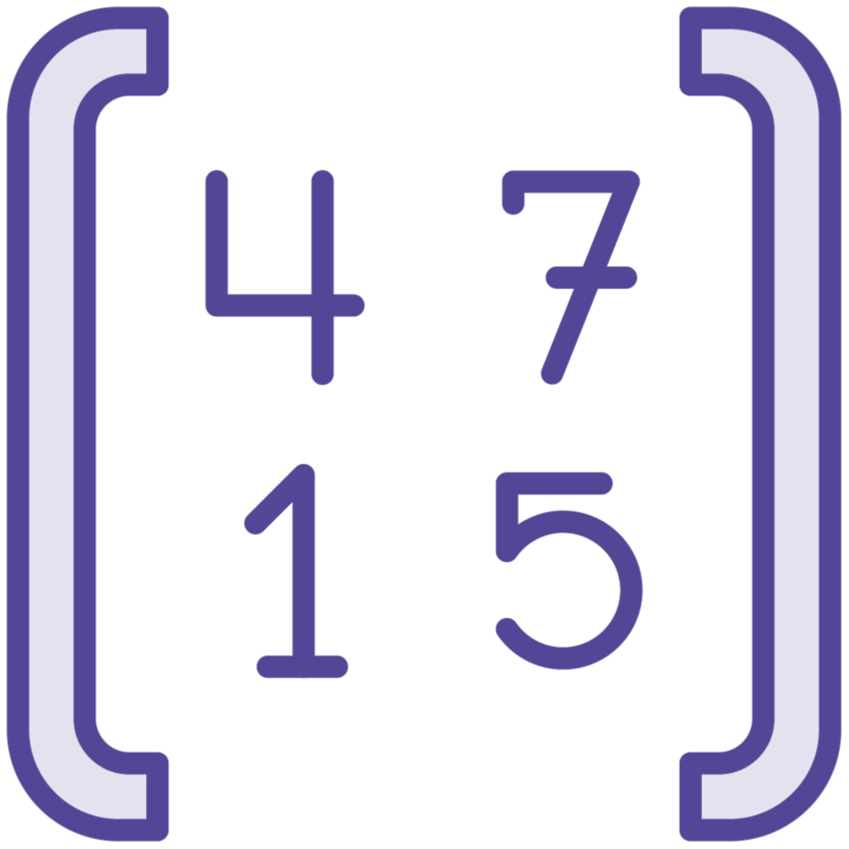



Tuple
Grouping of unnamed, ordered values
Often used for:
Multiple return values from a function
Intermediate results of a calculation
Values in a tuple can be of different types
Immutable
Simple equivalence checking
Great because they don’t need a type definition

Slide 199
Tuple definition
let tuple1 = 1, "a“ // int * string
let tuple2 = (1, "a") // int * string
let tuple3 = (1, "b") // int * string
let tuple4 = (1, "a", 2.0, true) // int * string * float * bool
tuple1 = tuple2 // true
tuple1 = tuple3 // false
tuple1 = tuple4 // error
Values separated by commas, optionally with parentheses
Type represented by type names separated with asterisks
Comparison is based on number of fields, order and type

Slide 200
Access to elements
let tuple = (1, "a")
fst tuple // val it: int = 1
snd tuple // val it: string = “a”
let third (_, _, c) = c // parens on a function mean function takes a tuple
// _ means ignore that element of the tuple
let tuple3 = (1, "b", 2.0)
third tuple3 // val it: float = 2.0
fst function for first element of a 2 element tuple
snd function for second element of a 2 element tuple
Easy to make deeper accessors (third above)
Note the function declarations use of parenthesis and underscores

Slide 201
Pattern matching / destructuring
let (a, b, c) = (1, "b", 2.0)
// val c: float = 2.0
// val b: string = "b"
// val a: int = 1
let (_, b, _) = (1, "b", 2.0)
// val b: float = 2.0
let print tuple =
match tuple with
| (a, b) -> printfn "%A %A" a b
print (1, "a") // 1 “a”
Let with identifiers in () with commas capture values in those positions
match expression also pattern matches, without let

Slide 202
Use with functions
let divRem a b =
let x = a / b
let y = a % b
(x, y)
let (roundedResult, remainder) = divRem 11 2
roundedResult // val roundedResult: int = 5
remainder // val remainder: int = 1
Return a tuple by putting one or more values in parentheses
Can be destructured when catching result (or later)

Slide 203
Records

Slide 204

Records
Like tuples, but with names for elements

Slide 205
Record
Simple aggregates of named values (optionally with members)
https://docs.microsoft.com/en-us/dotnet/fsharp/language-reference/records

Slide 206
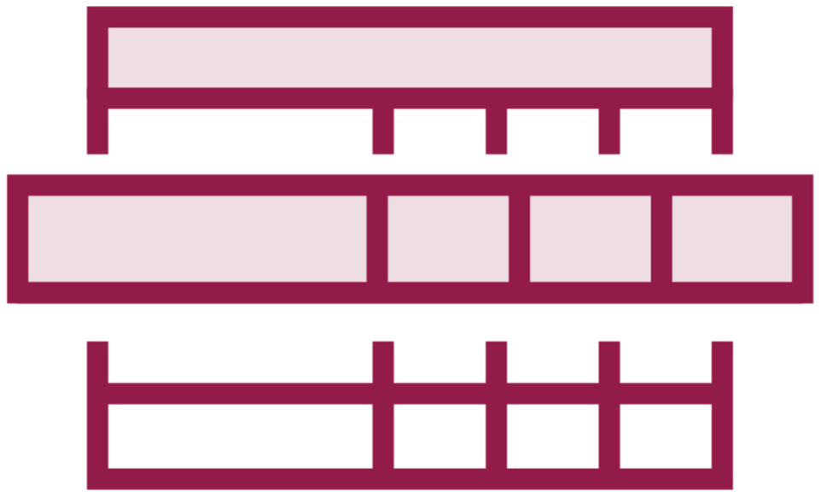
Record
Simple aggregates of named values
Optionally can contain members
Immutable

Slide 207
Declaration and use
type Person =
{
FirstName: string;
LastName: string;
Age: int;
}
let person1 = { FirstName = "John"; LastName = "Doe"; Age = 30 }
person1.FirstName // val it: string = "John"
Type keyword followed by the record’s type name
Brackets with field names and type
Note type name not needed when declaring an instance, the compiler infers the type
All fields and values must be specified during instantiation

Slide 208
Records can have members
type Person =
{
FirstName: string;
LastName: string;
Age: int;
}
with member this.FullName = $"{this.FirstName} {this.LastName}"
member this.IsSenior = this.Age >= 65
{ FirstName = "John"; LastName = "Doe"; Age = 65 }.FullName // John Doe
{ FirstName = "Jane"; LastName = "Doe"; Age = 55 }.IsSenior // false
{ FirstName = "John"; LastName = "Doe"; Age = 65 }.IsSenior // true
Members can be declared using with member
Followed by this.<Member Name>
this can be any name (self, me, …), just use it in the function body
Other named values accessed via this (or other name) dot name

Slide 209
Modifying records
let person1 = { FirstName = "John"; LastName = "Doe"; Age = 30 }
let person2 = { person1 with Age = 31 }
person2
val person2: Person = { FirstName = "John"
LastName = "Doe"
Age = 31 }
Records are immutable, can’t change value of a field with =
A new record can be created from a template record using the with keyword

Slide 210
Equivalence of records
let person1 = { FirstName = "John"; LastName = "Doe"; Age = 30 }
let person2 = { FirstName = "John"; LastName = "Doe"; Age = 30 }
let person3 = { FirstName = "John"; LastName = "Doe"; Age = 65 }
person1 = person2 // true
person1 = person3 // false
Fields are compared value to value for equivalence (structural equality)
Not by reference, and need for all that IEquatable nonsense

Slide 211
Discriminated Unions

Slide 212

Discriminated Unions
Values that can be one of a number of named cases

Slide 213
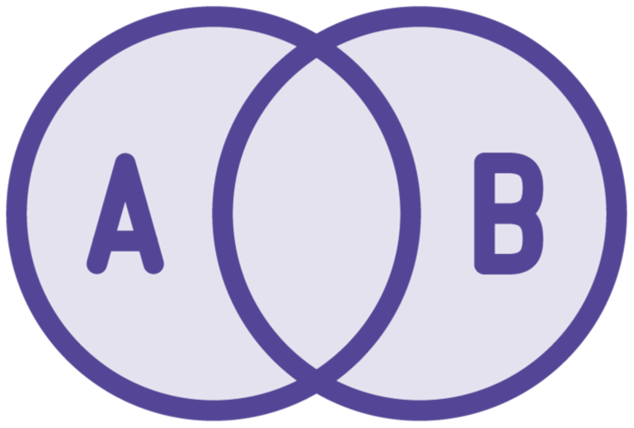
Discriminated Union
Values that can be one of a number of named cases (variants)
Must be one of the named cases / structures
Named case is a “constructor”
Value must be one of the cases
Sum types (tuples and records are product types)
Can have methods and properties
Notes:
Types define structure, type defines a set of choices / structions
Union in C / C++
Sum types

Slide 214
Discriminated Union Usage
// a one of a set of names
type DaysOfWeek = Sunday | Monday | Tuesday | Wednesday | Friday | Saturday
let day = Sunday; // DaysOfWeek
day = Sunday // val it: bool = true
day = Monday // val it: bool = false

Slide 215
Defining Constructor Parameters
type Shape =
| Rectangle of width : float * height : float
| Circle of radius : float
| Triangle of s1:float * s2:float * s3:float
let rect = Rectangle(width = 1, height = 2)
let circ = Circle (1.0)
let tri = Triangle(1., 2., 3.)
A constructor can have parameters
Parameters can be named or unnamed
Instances are then created by passing values for the parameters in the constructor

Slide 216
Pattern matching “polymorphic” functions
let perimeter shape =
match shape with
| Rectangle (width, length) -> 2. * (width + length)
| Circle radius -> 2. * System.Math.PI * radius
| Triangle (s1, s2, s3) -> s1 + s2 + s3
perimeter rect, perimeter circ, perimeter tri
val it: float * float * float = (6.0, 6.283185307, 6.0)

Slide 217
Pattern matching “polymorphic” functions
let isSquare shape =
match shape with
| Rectangle (width, height) -> width=height
| _ -> false
isSquare rect, isSquare (Rectangle(width=1., height=1.)), isSquare circ
val it: bool * bool * bool = (false, true, false)

Slide 218
Unwrapping
let (Rectangle (width, height)) = rect
val width: float = 1.0
val height: float = 2.0
Extracts the values from the discriminated union

Slide 219
Recursive Definitions
type BinaryTree =
| Leaf of int
| Node of BinaryTree * BinaryTree
let root = Node(Leaf(1), Node(Leaf(2), Leaf(3)))
let sum tree=
let rec walk current accum =
match current with
| Leaf value -> accum + value
| Node (left, right) -> (walk left accum) + (walk right accum)
walk tree 0
sum root
Type can reference itself
Useful for recursive data structures like trees

Slide 220
Options

Slide 221

Options
Safely replacing the NULL

Slide 222

The Billion Dollar Mistake: Nulls
Nulls = evil!

Slide 223

Options
Used when an actual value might not exist for a named value or variable
It is an actual type, not lack of a value / reference

Slide 224
The Options for an Option
Some(x)
Be concise and keep the text to four lines or fewer
None
Be concise and keep the text to four lines or fewer

Slide 225
A simple idea enabled by DU’s and generics
type 'a option =
| None
| Some of ‘a
let someThing = Some(1)
let noneThing = None
Bind either None, or Some with a generic value
So valuable it’s part of the standard library for F#

Slide 226
Option in use
let isItSomething thing =
match thing with
| None -> "nope, it's nothing"
| Some i -> $"Yes, it is something: {i}"
isItSomething someThing // val it: string = "Yes, it is something: 1"
isItSomething noneThing // val it: string = "nope, it's nothing"
When using match, you have to cover both possibilities

Slide 227
Combined with pattern matching, both cases of an Option must be handled

Slide 228
Using Option Module
Decorate a type with the [<Measure>] attribute

Slide 229
Units of Measure

Slide 230

Mars Polar Lander
Launched: January 3, 1999
Disintegrated: December 3, 1999
Why?
Premature termination of engine firing during landing
Mixed usage of metric and imperial measures – doh!
$165m loss
Public domain image / Wikipedia:
https://en.wikipedia.org/wiki/Mars_Polar_Lander

Slide 231

Units of Measure
Quantities with units

Slide 232

Units of Measure
Combine extra unit-of-measure metadata to numeric types and value
The type of a unit of measure is:
A floating point, decimal or signed integral type
With an extra unit annotation, indicated in brackets.
Compiler will then ensure numerics with only the same unit-of-measure are combined

Slide 233
Defining a unit of measure
[<Measure>] type cm
[<Measure>] type inch
[<Measure>] type m
[<Measure>] type sec
[<Measure>] type kg
[<Measure>] type lbs
Decorate a type with the [<Measure>] attribute

Slide 234
Association with numeric values
let x = 1<cm> // int
let y = 1.0<cm> // float
let z = 1.0m<cm> // decimal
Use the measure name in <> after the value

Slide 235
Combined units-of-measure
let distance = 1.0<m>
let time = 2.0<sec>
let speed = 2.0<m/sec>
let acceleration = 2.0<m/sec^2>
let force = 5.0<kg m/sec^2>
Just mix and match even with additional symbols

Slide 236
Combined units-of-measure
let distance = 1.0<m>
let time = 2.0<sec>
let speed = 2.0<m/sec>
let acceleration = 2.0<m/sec^2>
let force = 5.0<kg m/sec^2>
Just mix and match even with additional symbols

Slide 237
Derived units-of-measure
[<Measure>] type N = kg m/sec^2
let force1 = 5.0<kg m/sec^2>
let force2 = 5.0<N>
force1 = force2 // true
Define a new unit of measure with the combined measures (and symbols)

Slide 238
Conversion between units of measures
[<Measure>] type degC
[<Measure>] type degF
let convertDegCToF c =
c * 1.8<degF/degC> + 32.0<degF>
// test
let f = convertDegCToF 0.0<degC>
Define a conversion value that uses both units
And multiply the source value by the conversion factor

Slide 239
Equatability

Slide 240

Equality
F# utilizes structural equality

Slide 241
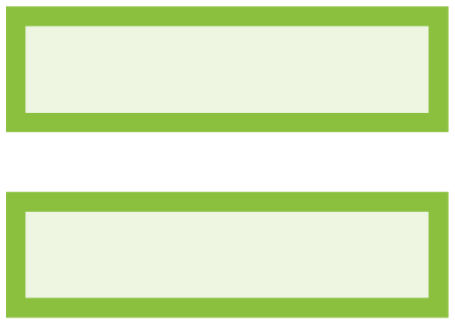
Equality
Structural equality is the default in F#
Two pieces of data are said to be equal if:
They have the same structure
All values in the two objects are equal
Equality is checked using the = operator
This can be overloaded for certain types
And calls the Equals method on .NET objects
== operator can be used for reference equality
Can be more efficient by preventing copying

Slide 242
Summary
Notes:
Congratuations, you have already created a small F# program
It’s a small program, but you will grow it over the course
You’re on your way to being a real F# programmer
And now lets have a recap to summarize what we’ve covered in this module

Slide 243
Up next:
Collections
Notes:
Now that you are on track to becoming and F# developer,
And you have everything is installed to continue
It’s time to start to learn functional programming
And that’s exactly what you;’ll do in the next module

Slide 244
F# 6 Fundamentals
Collections
Michael Heydt
Developer and Trainer
@mikeheydt www.smac.io
Notes:
Hello, and welcome to F# 6 Fundamentals.
My name is Micahel Heydt, and I’m very exicted to bring to you this course and to have you join me in learning f#.
We’re going to have a lot of fun learning about this awesome programming language.

Slide 245
Overview
Notes:
With all of this introduction to the course and .NET ecosystem out of the way, let’s start getting our hands dirty learning F#.
We’ll start this by starting with a first lesson called hello f# where we’ll learn a bit of the history of F#, what you can build with it, and WHY you would use F#.
Then we will learn about the various tools that you will need to use to develop in F#, third party tools, and both IDE, interactive and notebook environments.
I intend that you can follow along with this course with your own environments, so I’ll walk you through setting up an F# development environment and show you several means of using them.
We’ll then start creating code from the ground up.
We will start by learning how to use the .NET CLI to create, build and run F# projects.
Then we will shift our focus to Visual Studio Code, and we’ll use Visual Studio Code to run and debug F# projects, and also to use the environment to interactively run F# code in script files interactively with F# interactive, all within VS Code.
And we’ll finish this first module there, leaving you with knowledge of using the tools in various patterns to utilize F#, setting you up for the following module where we start diving deeply into F#.
Let’s dive in.

Slide 246
Lists

Slide 247

List
Like an Immutable Array

Slide 248
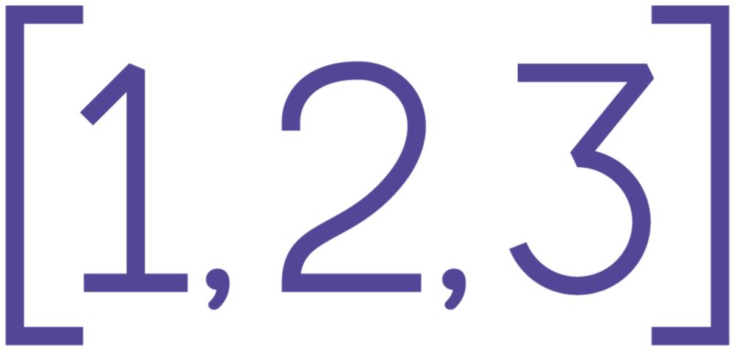
Lists
Ordered, immutable series of elements
Implemented via a single linked list
O(n) find / item lookup
Immutable
Elements can not be changed
Size cannot be changed
All elements are of the same type
But can be of a common base type
Support for slicing

Slide 249
Declaring a list
let list1 = [1; 2; 3] // single-line list<int>
let list2 = [ // multi-line list<int>
1
2
3
]
let list3 : float list = [1.; 2.; 3.] // list<float>
let list4 = [1..5] // val it: int list = [1;2;3;4;5]
Use [] with items separated with semicolons or new lines

Slide 250
Pattern match to head and tails with cons operator ::
let head :: tail = [1;2;3;4]
val tail: int list = [2; 3; 4]
val head: int = 1
Head is first item
Tail is a list of the remaining items

Slide 251
Built-in cons and concatenation operations
let list1 = [1;2;3]
let list2 = [4;5;6]
list1[1] // 2 (i+1 element in 0 based list)
10 :: list1 // [19;1;2;3]
list1 @ list2 // [1;2;3;4;5;6]
Infix cons (::) to make a new list with a new first element
Concat (@) makes a new list with the two lists combined

Slide 252
Properties
let list = [ 1; 2; 3 ]
list.IsEmpty // false
list.Length // 3
list.Head // 1
list.Tail // [2;3]
list.Tail.Head // 2
list.Tail.Tail.Head // 3
list.Item(1) // 2

Slide 253
Arrays

Slide 254
Arrays
Similar to lists but with a few operational and performance differences

Slide 255
Arrays
Fixed in size at time of allocation
Contiguous block of memory
Zero based indexes
O(1) element access times
Items must be the same type
Or implicitly convertable
Items are mutable using <- operator
No cons operator but can be sliced
Also comprehension capable

Slide 256
Creating arrays
[||] // val it: ‘a[]
[|
1
2
3
|] // val it: int[] = [|1; 2; 3|]
[|1..5|] // val it: int[] = [|1; 2; 3; 4; 5|]
[|for x in 1..5 -> x*x|] // val it: int[] = [|1; 4; 9; 16; 25|]
let array : float list = [1.; 2.; 3.] // val array: float array = [|1.0; 2.0; 3.0|]
Many flexible techniques for creation

Slide 257
Accessing elements
let array = [|1..5|] // val array: int[] = [|1; 2; 3; 4; 5|]
array.Length // val it: int = 2
array[1] // val it: int = 2
array[1] = 3 // val it: bool = false
array.[0] // val it: int = 1
array[1] <- -2 // val it: unit = ()
array // val it: int[] = [|1; -2; 3; 4; 5|]
Use the indexer operator []
Can set an element’s value with <-

Slide 258
Multi-dimensional arrays
let array2d = [| [|1..3|]; [|4..6|] |] // val array2d: int[][] = [|[|1; 2; 3|]; [|4; 5; 6|]|]
array2d[1][2] // val it: int = 6
let my2DArray = array2D [ [ 1..3]; [4..6] ] // val my2DArray: int[,] = [[1; 2; 3]; [4; 5; 6]]
my2DArray[1,2] // val it: int = 6
Arrays can be on n-dimensions

Slide 259
Array module
Array.empty // val it: 'a[]
Array.create 5 1.0 // val it: float[] = [|1.0; 1.0; 1.0; 1.0; 1.0|]
Array.zeroCreate 5 // val it: int array = [|0; 0; 0; 0; 0|]
Array.init 5 (fun index -> index * index) // val it: int[] = [|0; 1; 4; 9; 16|]
Useful creation functions and much more

Slide 260
Array module: concat, append and copy
let array1 = [|1..3|] // val array1: int[] = [|1; 2; 3|]
let array2 = [|4..5|] // val array2: int[] = [|4; 5|]
let array3 = [|6|] // val array3: int[] = [|6|]
Array.append array1 array2 // val it: int[] = [|1; 2; 3; 4; 5|]
Array.concat [array1; array2; array3] // val it: int[] = [|1; 2; 3; 4; 5; 6|]
Array.copy array1 // val it: int[] = [|1; 2; 3|]
No intrinsic support for these like with list and :: / @
But library support in the Array module
All return a new array

Slide 261
Slicing
let array = [|1..100|] // val array: int[] = [|1; 2; ...; 100 |]
// bounded on both ends
array[10..14] // val it: int[] = [|11; 12; 13; 14; 15|]
// first five
array[..4] // val it: int[] = [|1; 2; 3; 4; 5|]
// last five
array[96..] // val it: int[] = [|97; 98; 99; 100|]
Returns elements at positions in range [from..to]
0-based and inclusive at the ends
Can be unbounded at either end
Multi-dimensional and custom slicing also supported

Slide 262
Sequences

Slide 263

Sequences
Logical series of ordered elements, all of one type, but that are not all needed at once, or ever

Slide 264
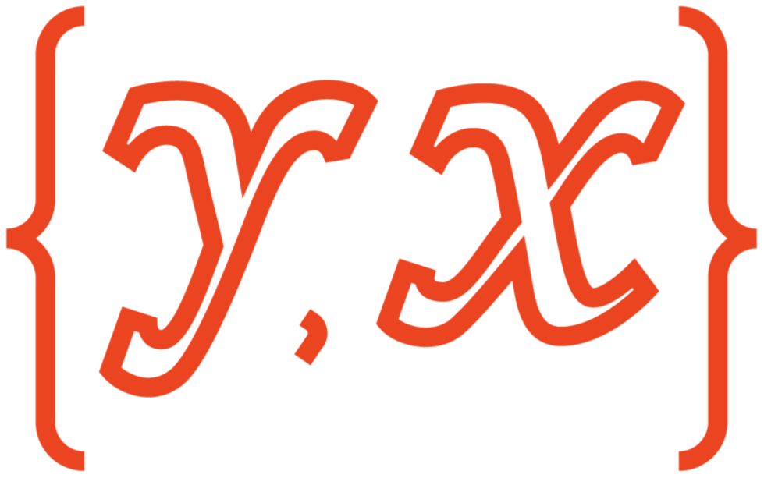
Sequences
Values are computed as required
Yields a new element on request for next
Think of yield in C#
Can provide better performance than a list
For large lists that consume a lot of memory
And are consumed one item at a time
Functions that accept a sequence…
inherently are compatible with lists, arrays, maps, sets
But not vice versa

Slide 265
Creating a sequence
seq {1..10} // val it: seq<int> = seq [1; 4; 9; 16; ...]
seq { for i in 1..10 -> i*i } // val it: seq<int> = seq [1; 2; 3; 4; ...]
Like arrays or lists but with seq {}

Slide 266
Efficiency
// this takes a while before output starts or running out of memory
for i in [1..100000000] do
if i < 10 then printfn "%A" i
// output starts immediately, barely uses any memory
for i in seq {1..100000000} do
if i < 10 then printfn "%A" i
A list or array must first be allocated before it can be used
Sequence starts right away and only takes the space O(1)

Slide 267
Sequences are useful as function return values
let isprime n =
let rec check i =
i > n/2 || (n % i <> 0 && check (i + 1))
check 2
let aSequence =
seq {
for n in 1..100 do
if isprime n then
n
}
for x in aSequence do printfn "%d" x
Calculation of the next prime is not done until the next iteration
Seq retains a state machine / closure on the generator which picks up where it last returned
Continues until the sequence completes

Slide 268
Maps, Sets and Dictionaries

Slide 269

Immutable Dictionary
F# immutable implementation of IDictionary<K,V>
All keys and values specified at initialization

Slide 270
Mutable Dictionary syntax
let inventory : IDictionary<string, float> =
[ "Apples", 0.33; "Oranges", 0.23; "Bananas", 0.45 ]
|> dict
let bananas = inventory["Bananas"]
// these are errors
inventory["Cherries"] <- 0.76
inventory.Add("Oranges", 0.25)
inventory.Remove("Tangerines")
dict function builds a read only dictionary from a sequence of key value pairs
Implements IDictionary<K,V> but immutable
Can infer the generic types

Slide 271
Mutable Dictionary
Simply the .NET generic dictionary object
Completely mutable
But you can leverage F# inference

Slide 272

Maps
Intrinsic F# type
Immutable
Each key maps to a single value
Like a dict, but with record like behavior
Good support to F# types and pipelining

Slide 273
Map syntax
let capitals = ["USA", "Washington D.C"; "Canada", "Ottawa"; "France", "Paris"] |> Map.ofList
val capitals: Map<string,string> =
map [("Canada", "Ottawa"); ("France", "Paris"); ("USA", "Washington D.C")]
let usa = capitals["USA"] // val usa: string = "Washington D.C"
let canada = capitals["Canada"] // val canada: string = "Ottawa“
let newCapitals =
capitals
|> Map.add "Japan" "Tokyo"
|> Map.remove "France“
val newCapitals: Map<string,string> =
map [("Canada", "Ottawa"); ("Japan", "Tokyo"); ("USA", "Washington D.C")]
Create set from list, array or sequence
Add and remove operations return a new map (old is left in-tact)
Adding a key that exists updates the old key (but still a new map)

Slide 274

Sets
Collection of distinct objects
Immutable
Sorted
Duplicates not allowed (but not an exception)

Slide 275
Set syntax
let set1 = ["A"; "B"; "A"; "A"; "C"] |> Set.ofList // set ["A"; "B"; "C"]
let set2 = [| "C"; "D"; "A"; "E"; "C" |] |> Set.ofArray // set ["A"; "C"; "D"; "E"]
let set3 = [| "B"; "C"|] |> Set.ofArray // val set3: Set<string> = set ["B"; "C"]
let set4 = set1.Add("Z") // set ["A"; "B"; "C"; "Z"]
let set5 = set2.Remove("F") // set ["A"; "C"; "D"; "E"]
let union = set1 + set2 + set3 // val union: Set<string> = set ["A"; "B"; "C"; "D"; "E"] let distinctToSet1 = set1 - set2 // val distinctToSet1: Set<string> = set ["B"]
let intersect = set1 |> Set.intersect set2 // val intersect: Set<string> = set ["A"; "C"]
let isSubset = set1 |> Set.isSubset set3 // val isSubset: bool = true
Create set from list, array or sequence
Automatically sorts items
Add and remove return new sets leaving existing unmodified

Slide 277
Collection Processing

Slide 278
Common Operations on Collections
Iteration
Filters
Maps
Grouping
Aggregation

Slide 279
Iteration
Filters
Map
Group
Aggregation
Taking a look at every item
Picking items based on a criteria
Transform an item into something else
Collecting like items in buckets
Derived values on a group or whole

Slide 280
Base data
type TransactionTypes = Deposit | Withdrawal | Transfer
type Transaction = { Year:int; Amount:float; Type: TransactionTypes }
let transactions = [
{Year=2021; Amount=100; Type=Deposit }
{Year=2022; Amount=50; Type=Deposit}
{Year=2022; Amount=25; Type=Withdrawal} ]
Some simple transaction data

Slide 281
Iterate
let printTransaction transaction = printfn "%A" transaction
List.iter printTransaction transactions
{ When = 1/1/2022 12:00:00 AM
Amount = 100.0
Type = Deposit }
{ When = 2/1/2022 12:00:00 AM
Amount = 50.0
Type = Withdrawal }
{ When = 4/1/2022 12:00:00 AM
Amount = 150.0
Type = Deposit }
Apply a function to each item
No return value from function, or from the iter function
Inherently a side effect based process

Slide 282
Iterate – with lambda function
// using a lambda
List.iter (fun transaction -> printfn "%A" transaction) transactions
{ When = 1/1/2022 12:00:00 AM
Amount = 100.0
Type = Deposit }
{ When = 2/1/2022 12:00:00 AM
Amount = 50.0
Type = Withdrawal }
{ When = 4/1/2022 12:00:00 AM
Amount = 150.0
Type = Deposit }
Preferable syntax allowing flow of data across functions

Slide 283
Iterate – with right pipe
// pipe right
transactions |> List.map printTransaction
{ When = 1/1/2022 12:00:00 AM
Amount = 100.0
Type = Deposit }
{ When = 2/1/2022 12:00:00 AM
Amount = 50.0
Type = Withdrawal }
{ When = 4/1/2022 12:00:00 AM
Amount = 150.0
Type = Deposit }
Preferable syntax allowing flow of data across functions

Slide 284
Filter
List.filter (fun transaction -> transaction.Year = 2022) transactions
val it: Transaction list = [{ Year = 2022
Amount = 50.0
Type = Deposit }; { Year = 2022
Amount = 25.0
Type = Withdrawal }]
Select items from a list using a predicate function (true/false based on data in the item)
Returns a new (possibly empty) list with matching items

Slide 285
Filter – dedicated function and pipe right
let transactionInYear year transaction = transaction.Year = year
List.filter (transactionInYear 2022) transactions
transactions |> List.filter (transactionInYear 2022)
Select items from a list using a predicate function (true/false based on data in the item)
Returns a new (possibly empty) list with matching items

Slide 286
Map
let getTransactionYear transaction = transaction.Year
let getTransactionAmount transaction = transaction.Amount
let getTransactionType transaction = transaction.Type
transactions |> List.map getTransactionAmount
val it: float list = [100.0; 50.0; 25.0]
transactions |> List.map getTransactionYear
val it: int list = [2021; 2022; 2022]
transactions |> List.map getTransactionType
val it: TransactionTypes list = [Deposit; Deposit; Withdrawal]
For each item in the collection, return a new item
Creates a new list of all the items

Slide 287
GroupBy
transactions |> List.groupBy getTransactionYear
val it: (int * Transaction list) list =
[(2021, [{ Year = 2021
Amount = 100.0
Type = Deposit }]);
(2022, [{ Year = 2022
Amount = 50.0
Type = Deposit }; { Year = 2022
Amount = 25.0
Type = Withdrawal }])]
Organizes items by a shared key
Returns a list of tuples
First value in each tuple is the key
Second value in each tuple is a list of the items sharing they key

Slide 288
Aggregate
// total of items in a list
List.sum [1;2;3]
val it: int = 6
// get all transaction amounts
transactions |> List.map getTransactionAmount
val it: float list = [100.0; 50.0; 25.0]
// sum of all transaction amounts
transactions |> List.map getTransactionAmount |> List.sum
val it: float list = 175.0
Calculates a value contingent on all the items in the input list
Ex: Sum, Average, Min, Max

Slide 289
Wait, that’s a total of amounts and not a balance

Slide 290
Calculating the balance
let adjustAmountForType transaction=
match transaction.Type with
| Withdrawal -> -transaction.Amount
| Deposit -> transaction.Amount
transactions
|> List.map adjustAmountForType
|> List.sum
val it: float = 125.0
Map to make negative amount for withdrawals, otherwise positive
Then run it through sum

Slide 291
Net per year
let netOfTransactions transactions =
transactions
|> List.map adjustAmountForType
|> List.sum
transactions
|> List.groupBy getTransactionYear
|> List.map (fun (year, transactionsForYear) ->
(year, transactionsForYear |> netOfTransactions))
val it: (int * float) list = [(2021, 100.0); (2022, 25.0)]
Group by year, then
Map each group (a tuple of year, transactions) to a new tuple (year, net of transaction amounts)

Slide 292
Topics in the module
Summary

Slide 293
Functions
Michael Heydt
Developer and Trainer
@mikeheydt www.smac.io

Slide 294
Topics in the module
Overview

Slide 295
Functions

Slide 296
Function
In the relational approach, a function f: X→Y is a binary relation between X and Y that associates to each element of X exactly one element of Y.
https://en.wikipedia.org/wiki/Function_(mathematics)

Slide 297
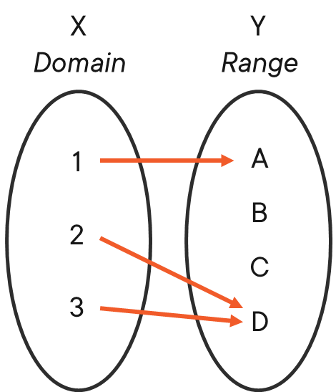
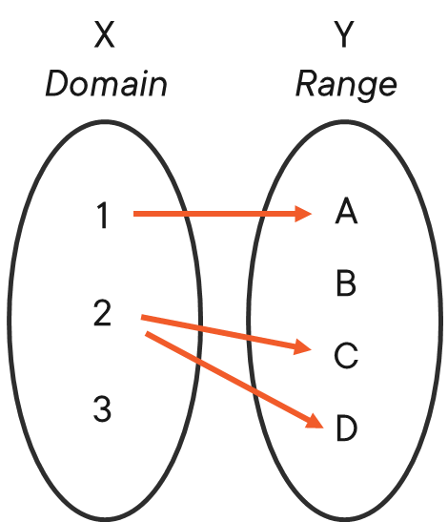
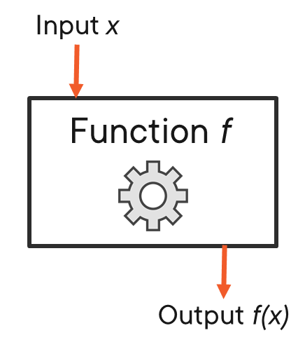
Visualizing Functions
Black-box
One input
One output
Maps Domain to Range
Single Valued
Each X only maps to one Y
Not a Function
Multiple Y for any X
This is bad

Slide 298
Composite Functions
X
Y
Z
Input: x=3
1
2
3
4
1
2
3
4
1
2
3
4
Function f
x²
f: X
Y
g: Y
Z
Output: f(x)=9
X
Z
Function g
x+1
1
2
3
4
1
2
3
4
Output: g(f(x))=10
g f: X
Z
o

Slide 299
let f x = x * x
let g x = x + 1
let gf x = (g << f) x
f 1
f 2
g 1
g 2
gf 2
f(x) = x²
g(x) = x + 1
g(f(x)
1
4
2
3
5

Slide 300
Functional Programming Concepts

Slide 301
Concepts of Functional Programming
Immutability
Recursion
Curried Functions
Higher-order Functions

Slide 302
Immutability
Bindings in F# are immutable by default
Therefore, the value bound to an name cannot be changed after the binding is created
This allows for efficiently implemented data structures
But can seem initially unnatural to those that use loops and other imperative concepts

Slide 303
Benefits of Immutable Data
Simplicity
Efficient translation from mathematic definition to code
Concurrent
Immutable data is inherently thread safe

Slide 304
Recursion
Loops can be converted to recursive constructs
These recursive constructs do not require an immutable accumulator or loop variable
This is often simpler and safer

Slide 305
Currying
Conversion of a function that takes multiple arguments into a sequence of functions each taking a single argument
https://en.wikipedia.org/wiki/Function_(mathematics)

Slide 306
Benefits of Curried Functions
Partial application
Composition
Reuse

Slide 307
Higher-order Functions
TBD

Slide 308
Four Key Concepts of F#
Function Oriented
Not object-oriented
Expressions
Rather than statements
Algebraic Types
For domain models
Pattern Matching
For control flow

Slide 309
Function Oriented
Functions are first class

Slide 310
Working with Functions

Slide 311
Single parameter function
let square x = x * x
val square: x: int -> int
Components of a function declaration include: let / name, parameters, body
Functions always return a value, even if that value is Unit ()

Slide 312
Return value
let square x = x * x
val square: x: int -> int
Functions are expressions, and expressions return a value, even if the value is ()

Slide 313
Multiline functions
let square x =
x * x
val square: x: int -> int
Functions can span multiple lines
Indent the body of the function

Slide 314
Function Signature
let square x = x * x
val square: x: int -> int
The type to the right of the rightmost arrow is the return type
All other types in the signature are function parameters
By default, all types are inferred, including the return type

Slide 315
Call a function
let square x = x * x
val square: x: int -> int
square 3
val it: int = 9
Function name followed by the parameters separated by spaces

Slide 316
This is an error
let square x = x * x
val square: x: int -> int
square 3.
error FS0001: This expression was expected to have type
'int'
but here has type
'float'
Float cannot be converted implicitly to int

Slide 317
Define type of parameter
let square (x: float) = x * x // explicitly make parameter a float
val square: x: float -> float
square 3.
val it: float = 9.0
square 3
val it: float = 9.0
One each parameter that needs a type, use (<name> : <type>)

Slide 318
Casting
float;;
val it: (int -> float) = <fun:it@59-7>
let square x = // x is an int
float (x * x) // implicit force of return type to float
val square: x: int -> float
square 3
val it: float = 9.0
square 3.
// error message omitted
Casting is performed using functions
Following with the functional nature of F#.

Slide 319
Specify return type
let square x: float = x * x // return type is float, x inferred to float
val square: x: float -> float
square 3
val it: float = 9.0
square 3.
val it: float = 9.0
let square (x:int) :float = x * x // return type is float, x set to int
: <type name> after parameters and before =
Note that x gets coerced to float
Keeping it int requires specifying the type for the parameter in ()

Slide 320
Function overloading is not possible in F#

Slide 321
No function overloading
let square x: float = x * x // ok
let square (x:int) :float = x * x // error, trying to redefine square
Functions cannot have multiple overloads like in C#

Slide 322
Multiple parameter functions
let add x y = x + y // int -> int -> int
add 1 2
val it: int = 3
// specifying multiple parameter types and return type
let add (x:int) (y:int) : float = // int -> int -> float
x + y
Functions cannot have multiple overloads like in C#
Need to specify type for parameters? Each specific parameter needs ()

Slide 323
Multiple parameter functions
let add x y = x + y // int -> int -> int
add 1 2
val it: int = 3
// specifying multiple parameter types and return type
let add (x:int) (y:int) : float = // int -> int -> float
x + y
Functions cannot have multiple overloads like in C#
Need to specify type for parameters? Each specific parameter needs ()

Slide 324
Function Application

Slide 325
square 3 + 1

Slide 326
(square 3) + 1 = 10?

Slide 327
(square 3) + 1 = 10?
square (3 + 1) = 16?

Slide 328
square 3 + 1 = 10
val square: x: int -> int

Slide 329
square 3 + 1 = 10
9

Slide 330
square 3 + 1 = 10
9
+ 1 = 10
val it: (int -> int -> int) = <fun:it@16-4>

Slide 331
square 3 + 1 = 10
9
+ 1 = 10
10
= 10

Slide 332
square 3 + 1 = 10
9
+ 1 = 10
10
= 10
val it: ('a -> 'a -> bool) when 'a: equality

Slide 333
square 3 + 1 = 10
9
+ 1 = 10
10
= 10
val it: bool = true

Slide 334
Multiple parameter functions
let distance x y =
let delta = x - y
if delta < 0 then -delta else delta
val distance: x: int -> y: int -> int
distance 1 2
val it: int = 1
distance 2 1
val it: int = 1
Function name followed by the parameter names separated by spaces.

Slide 335
Parameter
The definition of a value expected by a function
Citation: Author/Source, Title, Link/Short URL

Slide 336
Argument
The value provided for a parameter when calling a function
Citation: Author/Source, Title, Link/Short URL

Slide 337
Type inference rule of thumb
If you have a parameter without a type annotation then inference will tend to fail due to framework library overloads. Type specification on the parameter then force correctness
Citation: Author/Source, Title, Link/Short URL

Slide 338
When should I specify parameter types?

Slide 339
Outer functions (in an API)
Specify types to formalize the API.
Citation: Author/Source, Title, Link/Short URL

Slide 340
Prefix and Infix Functions

Slide 341
Prefix and Infix Operators
Prefix
Infix
distance 5 2
1 + 3

Slide 342
Using prefix like infix
1 + 3
(+) 1 3
Prefix operators can be used as infix
This is good for using the prefix operator via partial application
Put parentheses around the operator and the to the right

Slide 343
Partially applied custom infix
let add1 x = (+) x 1
add1 5
The infix notation lets us partially apply a previously infix operator

Slide 344
Why are infix operators helpful?
1 + 2 + 3 // 6
(1 + 2) + 3 // 6, + is associative
1 + (2 + 3) // 6
36 / (6 / 2) // 12 // "/" is not associative
(36 / 6) / 2 // 3
((+) ((+) 1 2) 3) // not as easy to read as 1 + 2 + 3. You like LISP?
Make expressions using binary functions readable
Prefix form is much harder to read
But good for partial application and currying
Thing is, you can choose which is best for you in F#

Slide 345
Defining and infix function
let distance x y = abs (x - y) // or
let distance x y = x - y |> abs
let (|><|) x y = x - y |> abs
5 |><| 2
// val it : int = 3
5 |><| 2 |><| 10 // left associative
// val it : int = 7
Wrap the name of the function in parentheses
Infix operators will be left associative

Slide 346
Partial Application and Currying

Slide 347
Wait, what is that function signature?

Slide 348
Wait, what is that function signature?
val distance: x: int -> y: int -> int

Slide 349
All F# functions can be considered as having one parameter
let distance x y = x - y |> abs
// val distance: x: int -> y: int -> int
Multiple parameter functions are syntactic sugar
x: int -> y: int -> int, or, x:int -> (y:int -> int)
distance is a function, taking an int that returns a function that takes an int and returns an int

Slide 350
Make sense?

Slide 351
Currying
Converting a single function of n arguments into n functions with a single argument
Citation: Author/Source, Title, Link/Short URL

Slide 352
Partial application
Applying some, but not all, of a functions arguments
Citation: Author/Source, Title, Link/Short URL

Slide 353
This is immensely important to functional programming for partial application and currying

Slide 354
Partial application and currying

Slide 355
Lambda Expressions

Slide 356

Lambda Functions
Single use functions without identifiers

Slide 357
Lambda function in use
List.map (fun x -> x * x) [1;2;3]
// [1;4;9]
(fun x y -> x – y |> abs) 10 20
// 10
// with types on the arguments
(fun (x:int) (y:int) -> x – y |> abs) 10 20
// 10
Declaration starts with fun
Then parameters
Instead of = use ->
Then the body

Slide 358
Recursive Functions

Slide 359
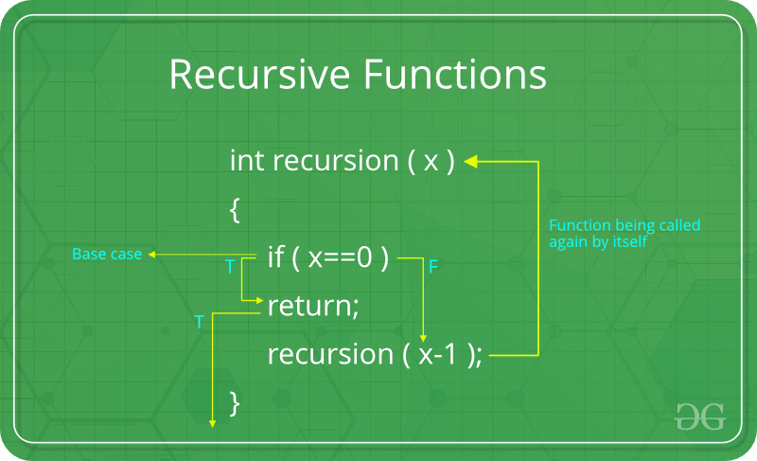
Recursive Function
A function that calls itself by passing its output back to itself

Slide 360



Properties of Recursive Functions
Base case
Defines root value and when to stop
Changes state and moves to the base case
Iterates to the next case or subdivides the problem
Calls itself
Makes a call to itself with data that is closer to the base case

Slide 361
Recursive functions in F# - explicit parameter and pattern match
let rec length x =
match x with
| [] -> 0
| x::xs -> 1 + length xs
length [1;2;3]
Needs keyword rec applied – allows function to reference itself
Special format that can be used without explicit arguments when pattern matching
Base case returns a value
Recursive cases return modified state and make a recursive call with a smaller set of data

Slide 362
Recursive functions in F# - implicit parameter and pattern match
let rec length = function
| [] -> 0
| x::xs -> 1 + length xs
length [1;2;3]
Pattern is so common that parameter and match are removed and made implicit

Slide 363
Tail recursive accumulator
let length list =
let rec loop list acc =
match list with
| head :: tail -> loop tail (acc + 1)
| [] -> acc
loop list 0
length [1;2] // val it: int = 2
Does not kill stack on large collections
Compiler optimizes the recursive call since return value is not required

Slide 364
Pipelines

Slide 365

Function Pipelines
Flowing data across functions

Slide 366
Pipe forward: |>
let (|>) = x f = f x
Symbol to the left of the pipe is applied to the function on the right as its first parameter
Allows flow of data across multiple functions without needing intermediate variables
Allows creation of very elegant code

Slide 367
Common F# pattern implemented with forward pipes
[1..4]
|> List.filter (fun i -> i % 2 = 0)
|> List.map ((*) 2) // or List.map (fun i -> i * 2)
|> List.sum
filter – map -> aggregate

Slide 368
Similar C# / LINQ
Enumerable.Range(1, 5)
.Where(i => i % 2 ==0) // filter
.Select(i => i * 2) // map
.Sum(); // aggregate
Requires explicit coding of extension functions instead of a generic |> operator / function

Slide 369
Pipe backward: <|
let mymap items mapper =
List.map mapper items
mymap [1;2;3] (fun i -> i * 2) // int list = [2; 4; 6]
mymap [1;2;3] <| fun i -> i * 2 // int list = [2; 4; 6]
[1..3] |> mymap <| fun i -> i * 2 // int list = [2; 4; 6]
Applies item on the right as the first parameter of the function expression on the left
Useful to change associativity from left to right
And to get rid of parenthesis

Slide 370
Higher Order Functions

Slide 371

Higher Order Functions
Functions returning or being passed functions

Slide 372
Higher order function
List.Map val it: (('a -> 'b) -> 'a list -> 'b list)
First arg is a function, that takes a list, and returns a list
Polymorphic function because of the generic parameters (parametric polymorphism)

Slide 373
Higher Order Function
A higher order function is a function that does at least one of the following:
takes one or more functions as arguments
returns a function as its result.
https://en.wikipedia.org/wiki/Higher-order_function

Slide 374

Uses of Higher Order Functions
Generic application of operations to each item in sets of data (maps, filters, …)
Folds
Composition
Callbacks
Inversion of control

Slide 375
Mapper
let map mapper items =
[for item in items -> mapper item]
map (fun i -> i * 2) [1..3]
val it: int list = [2; 4; 6]

Slide 376
Filter
let rec filter f list acc =
match list with
| head :: tail ->
if f head then
filter f tail (acc @ [head])
else
filter f tail acc
| [] -> acc
filter2 (fun i -> i % 2 = 0) [1..10]
val it: int list = [2; 4; 6]

Slide 377
Filter
let rec filter f list acc =
match list with
| head :: tail ->
if f head then
filter f tail (acc @ [head])
else
filter f tail acc
| [] -> acc
filter (fun i -> i % 2 = 0) [1..10]
val it: int list = [2; 4; 6]

Slide 378
Returning a function
let multiplyBy multiplier =
let result num = num * multiplier
result
// or shorter
let multiplyBy multiplier =
fun num -> num * multiplier
let multiplyBy3 = multiplyBy 3
multiplyBy3 10
val it: int = 30

Slide 379
Function Composition

Slide 380

Function Composition
Alternative to pipelines

Slide 381
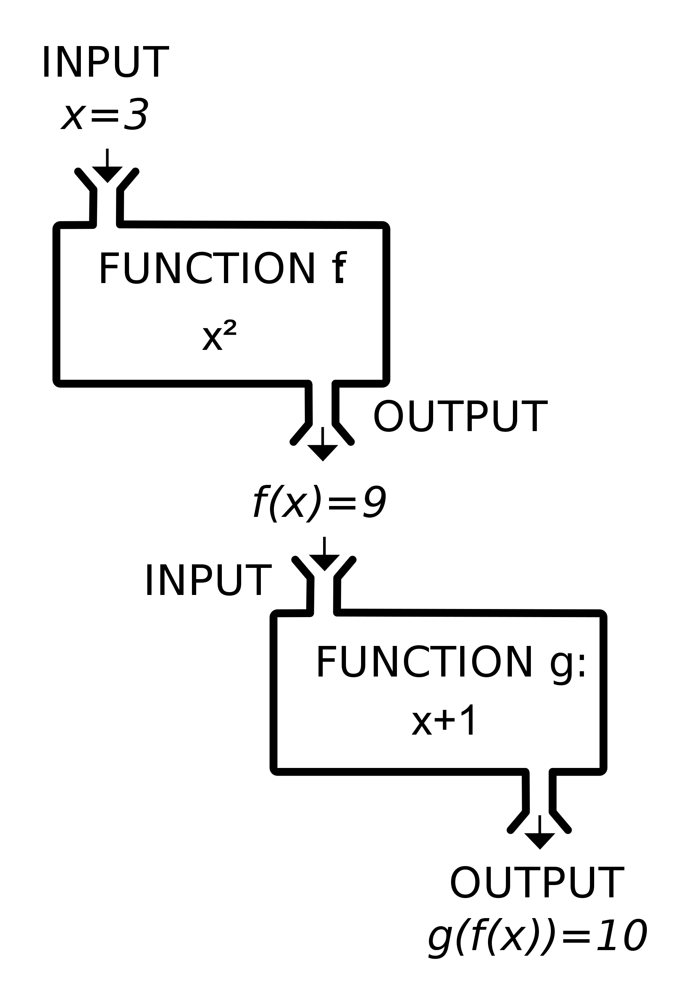
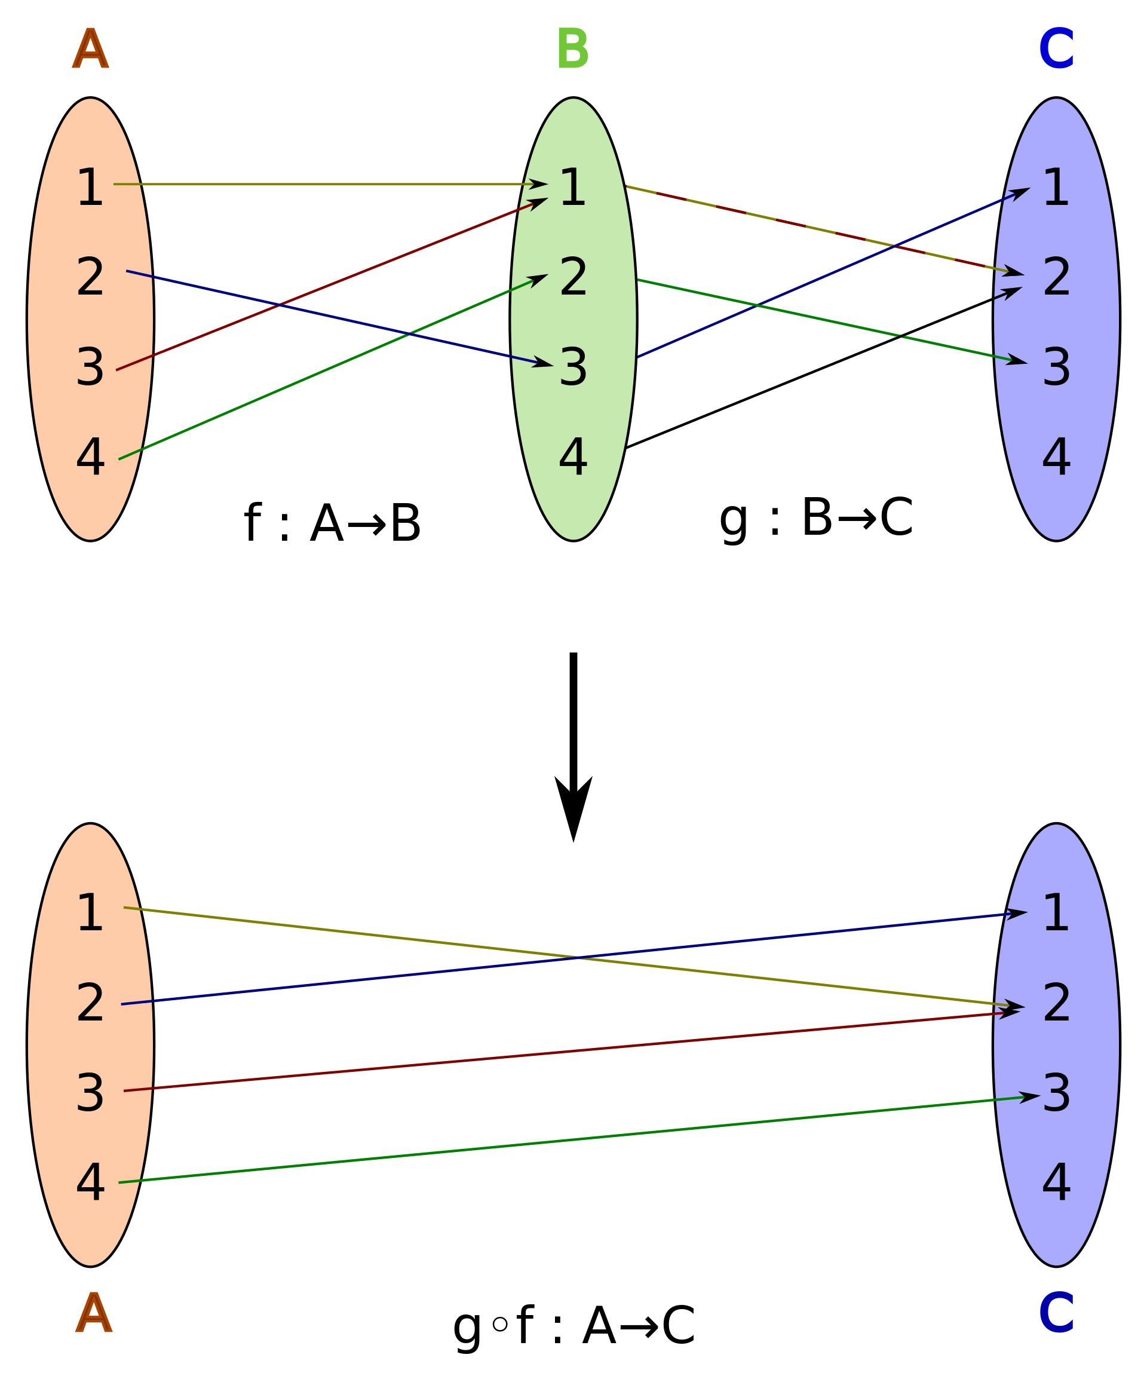
Composite Functions

Slide 382
h(x) = f(g(x))
Function Composition
Alternative to pipelines

Slide 383
Composition with >> and <<
let add1 x = x + 1
let times2 x = x * 2
let add1thenTimes2 = add1 >> times2
let times2thenAdd1 = add1 << times2
add1thenTimes2 5
val it: int = 12
times2thenAdd1 5
val it: int = 11

Slide 384
Composition with <<
let add1 x = x + 1
let times2 x = x * 2
let add1thenTimes2 = add1 >> times2
add1thenTimes2 5
val it: int = 12

Slide 385
Equivalency with pipelines
let add1thenTimes2_forwardPipe x =
x |> add1 |> times2
add1thenTimes2_forwardPipe 5
val it: int = 12
Or maybe not so much

Slide 386
Functional Design Patterns

Slide 387
Functional Design Patterns
Combinators
Higher-order functions that compose applications of other functions
Maps and Folds
Higher-order functions that apply a given function argument to a set of elements

Slide 388
Map
Higher-order function that applies a given function to a set of elements in order to create a new set of elements.

Slide 389
Fold
Higher-order function that applies a given function argument to a set of elements to accumulate a result.

Slide 390
Folds

Slide 391
Fold
A class of higher order functions that analyze a recursive data structure through the use of a combining operation, recombine the results of recursively processing its constituent parts, building up a return value.
Fold (higher-order function) - Wikipedia

Slide 392

Folds
Aggregate computation on a collection that requires an accumulator to calculate

Slide 393

Folds
Initialize an accumulator
Iterate across items in a collection
Modify accumulator based on each item
Return the accumulator as a result

Slide 394
Example Folds
Sum
Average
Count

Slide 395
Imperative sum “fold”
let sumImperative items =
let mutable accum = 0 // empty accumulator
for item in items do // go through every item
accum <- accum + item // update accumulator
accum // return accumulator
sumImperative [1..10]
val it: int = 55
Works fine
But we can do better

Slide 396
Recursive sum “fold”
let rec sum items accum =
match items with
| [] -> accum
| h::t -> sum t (h + accum)
sum [1..10] 0
val it: int = 55
Is a nice derivation
But subject to error: must remember to pass 0 as the initial accumulator

Slide 397
Better recursive sum “fold”
let rec sum items =
let rec internalRecursiveSum items accum =
match items with
| [] -> accum
| h::t -> internalRecursiveSum t (h + accum)
internalRecursiveSum items 0
sum [1..10]
val it: int = 55
Better signature as there is no need to pass an initial accumulator

Slide 398
F# gives us a better way

Slide 399
let sum items =
Seq.fold
(fun state item -> state + item)
0
items
sum[1..10]
val it: int = 55
Start a fold
Receives current state and the next item
Initial state
Input collection

Slide 400
Fold Calculating a Sum
let sum items =
Seq.fold
(fun state item ->
let newState = state + item
printfn "Current state: %A, item: %A, new state: %A“ state item newState
newState)
0
items
sum[1..5]
Current state: 0, item: 1, new state: 1
Current state: 1, item: 2, new state: 3
Current state: 3, item: 3, new state: 6
Current state: 6, item: 4, new state: 10
Current state: 10, item: 5, new state: 15
val it: int = 15

Slide 401
fold and foldBack (with arrays)
// using infix plus operator, forward through collection
let sum items = Array.fold (+) 0 items
sum [|1..10|]
val it: int = 55
// array to list, but walking from end to from
let toList array = Array.foldBack (fun h t -> h :: t) array []
toList [|1..10|]
val it: int list = [1; 2; 3; 4; 5; 6; 7; 8; 9; 10]

Slide 402
Results

Slide 403
Result
type Result<'T,'TError> =
| Ok of ResultValue:'T
| Error of ErrorValue:'TError
Alternative to throwing exceptions
Result allows returning either
The result value, or
Failure information
Exception tend to break composition
Makes explicit:
That a function can fail, and
Matching makes sure you handle both
Basis for a form of function composition called railway oriented programming
Notes:
Types define structure, type defines a set of choices / structions
Union in C / C++
Sum types

Slide 404
type Request = {
Name: string;
Email: string
}
let validateName request =
match request.Name with
| "" -> Error "Name is empty"
| _ -> Ok request
let validateEmail request =
match request.Name with
| "" -> Error "Email is empty"
| _ -> Ok request
The item we are validating and running through the railroad
Validation #1
Validation #2

Slide 405
Result Functions (Railway Switches)
Function
Purpose
bind
map
mapError
Forwards the result to another function
Applies a function to the Ok portion
Applies a function to the Error portion

Slide 406
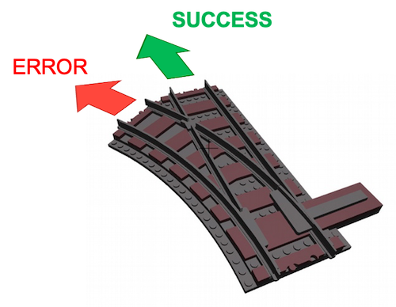
Railway programming (in a nutshell)
Send both Ok and Error to a function
Send only Ok along the happy path
Send only Error along an alternate path
Wire all the paths together at the start
Creates a type of data flow network
Extremely easy to:
Reason about
Guarantee expected results

Slide 407
let validateRequest request =
let validateResult =
(Ok request)
|> Result.bind validateName
|> Result.bind validateEmail
match validateResult with
| Ok req ->
printfn “Validated"
| Error e ->
printfn $“Error: {e}"
validateRequest // succeeds
{
Name="John";
Email="john@foo.bar"
}
validateRequest // fails
{
Name=""; Email=""
}
Define the railway
Start off with an Ok result
Send Ok and Error to validateName
Send Ok and Error to validateEmail
Handle results in one place
Validation #1 - succeeds
Validation #2 - fails

Slide 408
Rule of thumb: Use exceptions when you don’t want to reason about the error. Results are for when you want to do something depending on success or failure

Slide 409
Dependencies as Functions

Slide 410



Dependency Injection
Inverting Control with Function Parameters

Slide 411
Dependency Inversion
Here is where you put the definition. This is one of the few places where complete sentences are appropriate. Be sure to cite your source.
Citation: Author/Source, Title, Link/Short URL

Slide 412
Inversion of Control
Here is where you put the definition. This is one of the few places where complete sentences are appropriate. Be sure to cite your source.
Citation: Author/Source, Title, Link/Short URL

Slide 413
Managing State

Slide 414
Mutable State
let array3 = [| for i in 1 .. 10 -> i * i |]
let array4 = [|1..3|]
let arrayOfFiveZeroes : int array = Array.zeroCreate 10
Let with identifiers in () with commas capture values in those positions
match expression also pattern matches, without let

Slide 415
Immutable State
let array3 = [| for i in 1 .. 10 -> i * i |]
let array4 = [|1..3|]
let arrayOfFiveZeroes : int array = Array.zeroCreate 10
let array3 = [| for i in 1 .. 10 -> i * i |]
let array4 = [|1..3|]
let arrayOfFiveZeroes : int array = Array.zeroCreate 10
Let with identifiers in () with commas capture values in those positions
match expression also pattern matches, without let

Slide 416
Benefits of flowing state through function calls
You can reason about behavior much more easily
Function calls are repeatable

Slide 417
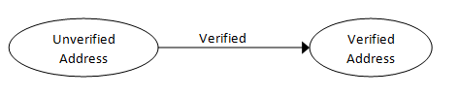
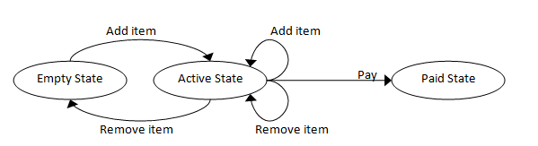
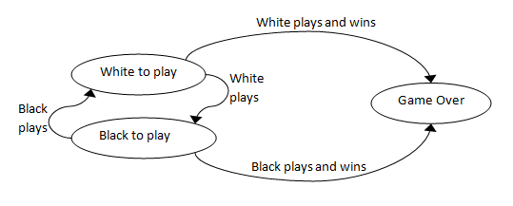

Slide 418
Reasons to use State Machines
Each state can have different allowable behavior
All the states are explicitly documented
They mak you think about every possibility

Slide 419
Topics in the module
Summary

Slide 420
Next Steps in F#
Michael Heydt
Developer and Trainer
@mikeheydt www.smac.io
Notes:
Hello, and welcome to F# 6 Fundamentals.
My name is Micahel Heydt, and I’m very exicted to bring to you this course and to have you join me in learning f#.
We’re going to have a lot of fun learning about this awesome programming language.

Slide 421

Object-orientation
Full support for .NET style classes
Some differing syntax for various OO constructs

Slide 422
type Line = class
val X1 : float
val Y1 : float
val X2 : float
val Y2 : float
new (x1, y1, x2, y2) as this =
{ X1 = x1;Y1 = y1;X2 =x2;Y2 = y2;}
then
printfn " Creating Line: {(%g, %g), (%g, %g)}\nLength: %g"
this.X1 this.Y1 this.X2
this.Y2 this.Length
member x.Length =
let sqr x = x * x
sqrt(sqr(x.X1 - x.X2) +
sqr(x.Y1 - x.Y2) )
end
let aLine = new Line(1.0, 1.0, 4.0, 5.0)
aLine.Length // val it: float = 5.0
Class definition
Fields
Constructor
Field initialization
Constructor code
Member function
End of class definition
Create a line
Get the lines length

Slide 423

Databases
Access to most, if not all, database
Entity Framework 6.0 support
ADO.NET support
If there is a .NET client, you can use it

Slide 424
[<CLIMutable>]
type Person =
{ PersonId : int
FirstName : string
LastName : string
Address : string
City : string
}
type PersonDataContext() =
inherit DbContext()
[<DefaultValue>]
val mutable persons : DbSet<Person>
member public this.Persons with get() = this.persons and
set p = this.persons <- p
override __.OnConfiguring(optionsBuilder
: DbContextOptionsBuilder) = optionsBuilder.UseSqlServer(
"YOUR CONNECTION STRING") |>
ignore
Entity as a CLI mutable object
DB Context
Person DbSet
Property get/set for the Person DBSet

Slide 425
Rule of thumb: If you don’t have to use classes, then stick to the functional data types

Slide 426

Type Providers
Smart data access technique for F#
Understand the underlying data and expose a functional data API
Brings in intellisense base on the data

Slide 427
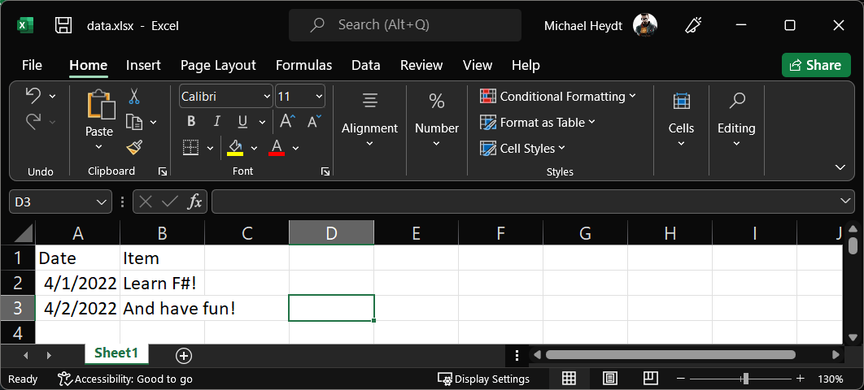
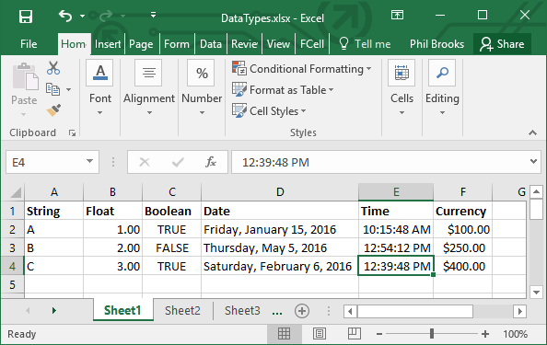
Example Excel File

Slide 428
#r "nuget: ExcelProvider"
open FSharp.Interop.Excel
type MyExcelProvider =
ExcelFile<“data.xlsx">
let file = new MyExcelProvider()
let row = file.Data |> Seq.head
(row.Date, row.Item)
val it: System.DateTime * string = (4/1/2022 12:00:00 AM, "Learn F#!")
Reference the Excel type provider
Define a type based on your Excel file
Create an instance of the provider
Read in the file
Note that the properties exist for the columns!

Slide 429

Web Applications
F# has a great ecosystem for Web Apps
From both Microsoft and open source

Slide 430
F# Web Application Tools
ASP.NET Core / MVC
Giraffe
Saturn
Fable
SAFE Stack (Saturn, Azure, Fable and Elmish)
WebSharper

Slide 431
module Program =
[<EntryPoint>]
let main args =
let builder = WebApplication
.CreateBuilder(args)
builder.Services.AddControllers()
let app = builder.Build()
app.UseHttpsRedirection()
app.UseAuthorization()
app.MapControllers()
app.Run()
0
Define module
This method is the entry point
Create the web application builder
Use controllers as services
Now build up the app
And run the web app

Slide 432
type HomeController
(logger : ILogger<HomeController>) =
inherit Controller()
member this.Index () = this.View()
member this.Privacy () = this.View()
[<ResponseCache(Duration = 0,
Location = ResponseCacheLocation.None,
NoStore = true)>]
member this.Error () =
let reqId =
if isNull Activity.Current then
this.HttpContext.TraceIdentifier
else
Activity.Current.Id
this.View({ RequestId = reqId })
Controller definition with injected logger
Inherit from controller
Request handlers

Slide 433


Web API’s
Like web apps, F# is also great for API’s

Slide 434
[<ApiController>]
[<Route("[controller]")>]
type WeatherForecastController (logger : ILogger<WeatherForecastController>) =
inherit ControllerBase()
let summaries = [| "Freezing";
"Bracing“; "Chilly"; "Cool"; "Mild";
"Warm“; "Balmy"; "Hot“; "Sweltering";
"Scorching“ |]
[<HttpGet>] member _.Get() =
let rng = System.Random()
[| for index in 0..4 ->
{ Date = DateTime.Now.AddDays(float index)
TemperatureC = rng.Next(-20,55)
Summary = summaries.
[rng.Next(summaries.Length)]
}
|]
This is an API controller
The route specifier
Constructor with injected logger
Derives from ControllerBase
Static data
GET verb handler

Slide 435

Microservices
F# microservices are simple to create
Build on .NET 6
Write code as normal for a microservice
Run in a Linux container

Slide 436

C# Interop
F# easily utilizes C# assemblies
C# can utilize F# assemblies
Tuples and records feel natural in C#
Discriminated unions have a special syntax

Slide 437
// F#
namespace MyFsharpLib
type Record = { Name: string; Age: int }
type Abc =
| A
| B of double
| C of Record
// C# using the above F#
using MyFsharpLib;
var aDU = Abc.NewC(new Record("John", 55);
var result = aDU switch {
Abc.B v => $"{v}",
Abc.C r => $"{r.Item.Name} {r.Item.Age}“,
_ => "Is an A"
};
Define the namespace
And a record
And a discriminated unio
Use the F# namespace
Create a C version of the DU
Use C# pattern matching to handle all cases
Must handle all cases

Slide 438
That’s pretty cool!

Slide 439

Concurrency
Ability to create async workflows

Slide 440
let printTotalFileBytes path =
async {
let! bytes =
File.ReadAllBytesAsync(path)
|> Async.AwaitTask
let fileName =
Path.GetFileName(path)
printfn $"File {fileName} has %d{bytes.Length} bytes"
}
[<EntryPoint>]
let main argv =
argv
|> Seq.map printTotalFileBytes
|> Async.Parallel
|> Async.Ignore
|> Async.RunSynchronously
0
async computation expression
let! Is used to bind the result of another computation expression
Compute length of all files in argv
Handle parallel results as a sequence
Runs function on all the argv elements
Ignore the async results
Start all the parallel execution

Slide 441

Check out the functional and .NET courses on Pluralsight

Slide 442

Congratulations on finishing this course!

Slide 443

X
Domain
Y
Range
X
Domain
Y
Range
Input x
Function f
1
2
3
A
B
C
D
1
2
3
A
B
C
D
Output f(x)

Slide 444
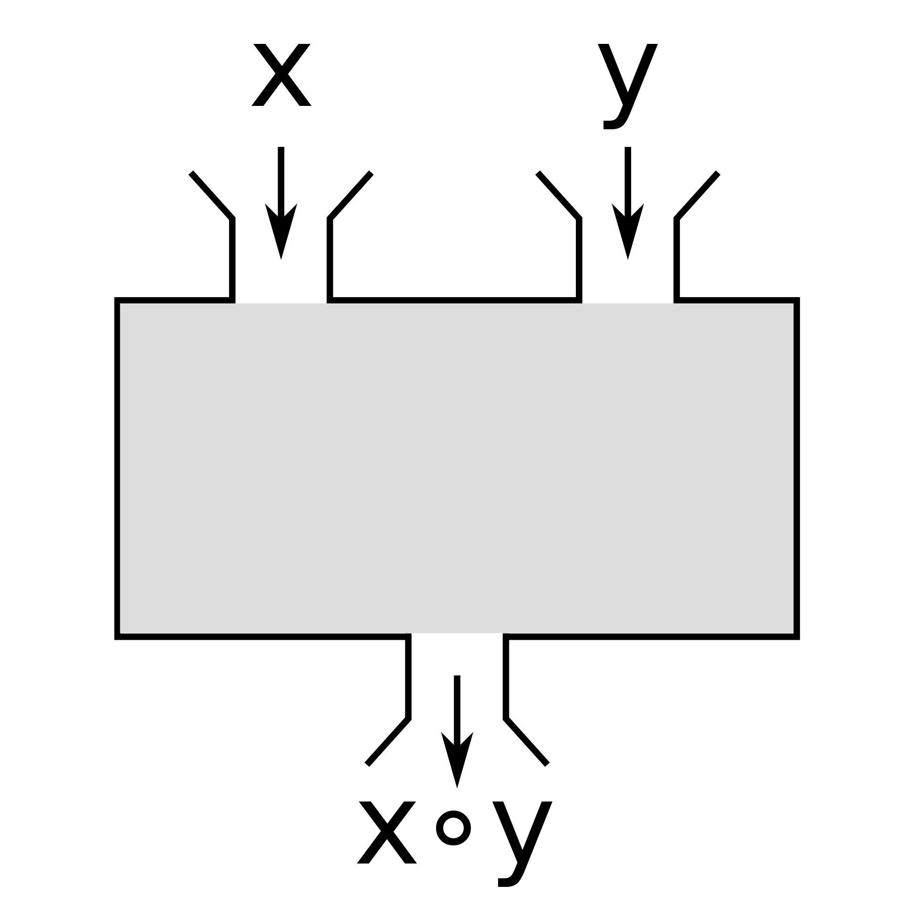
Binary Functions

Slide 445
Composite Functions

